Slide 1
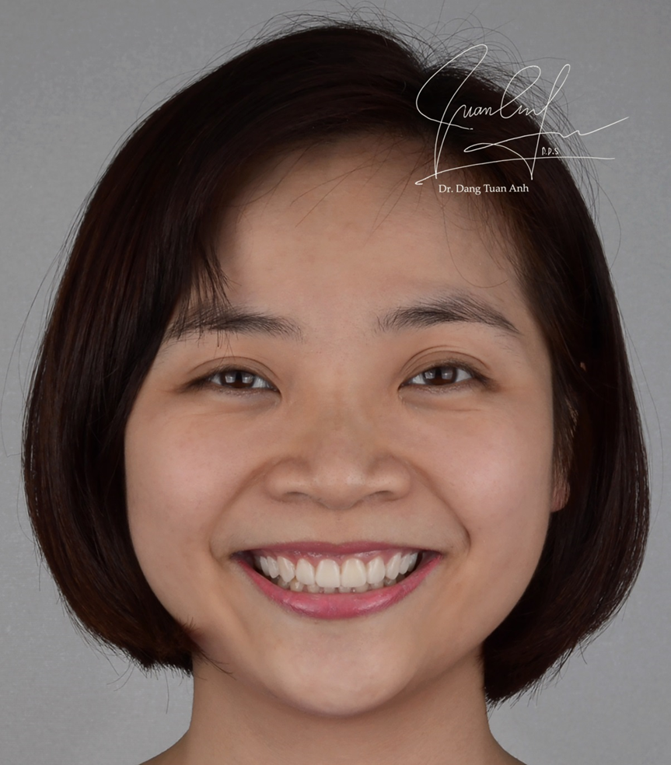
DIGITAL SMILE DESIGN
Veneer case report
Patient name: N.T.L
Clinician: Dr Đặng Tuấn Anh
Prosthodontist
Department of Prosthodontic Dental School, Haiphong University of Medicine and Pharmacy
Chef complain:
Teeth rotation
Lingual-inclination of upper anterior teeth
Dark-colored teeth
Patient ‘s desire:
Changing the tooth form
Brightening teeth color
Refusing orthodontic treatment

Slide 2
Treatment planTra
Digital Smile Design with DSD (Digital smile design) concept.
Bite registration of the patient in function positions with Semi adjustments Mounting bio art A7 plus, Using Facebow and articulator Bioart A7 Plus.
Wax up for 10 Anterior veneers, Directly mock-up for patient on teeth from 15-25 with Luxatemp B1
After agreed between dentist and patient, conduct adjusting gummy smile and minimal invasive treament preparation 0.3mm. Taking impression by Honigum DMG (putty and Light)
Final Veneers from the technician which complied exactly as Mock-up designed by DSD and with patient permission.
Final Cementation used Variolink Esthetic LC, Neutral Shade, Isolated by Rubber dam and Clamp B4 for anterior teeth.

Slide 3
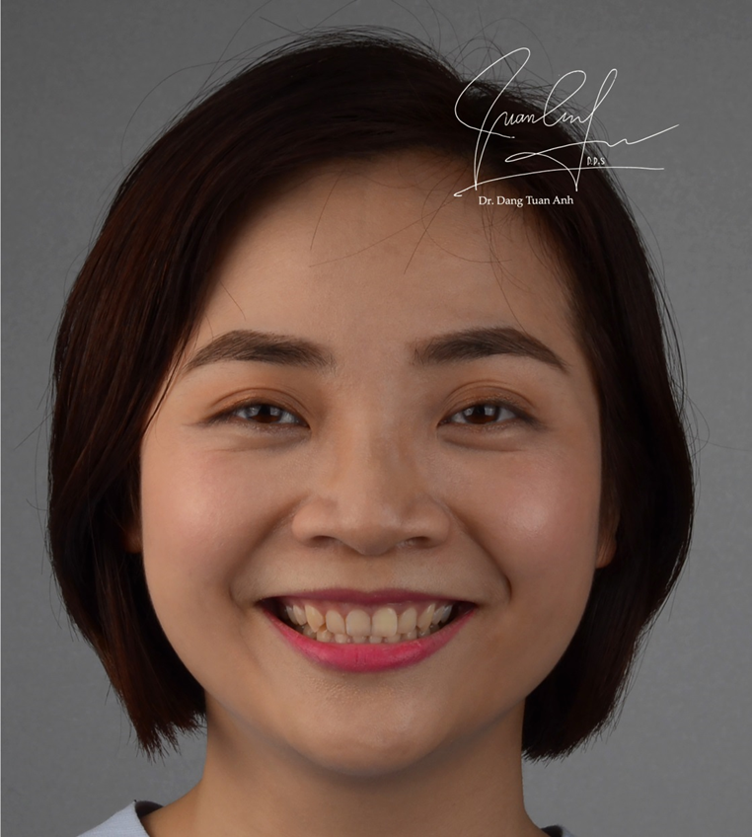
Initial situation

Slide 4
Initial situation

Slide 5
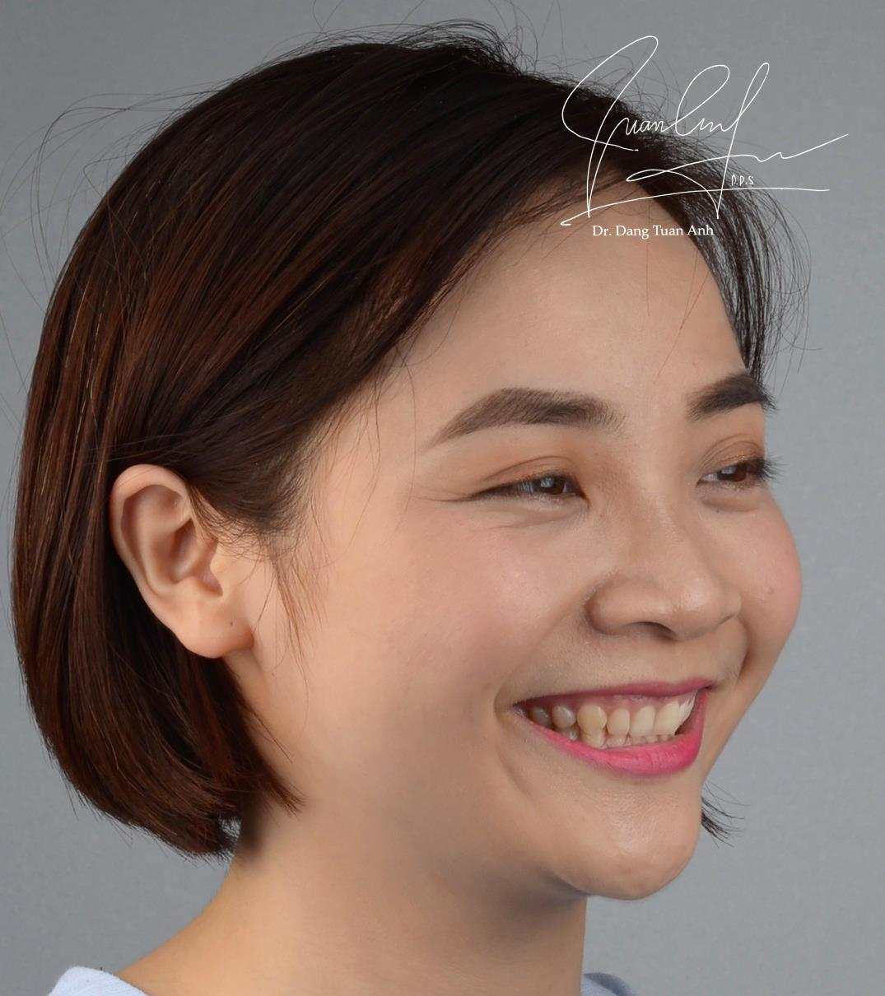
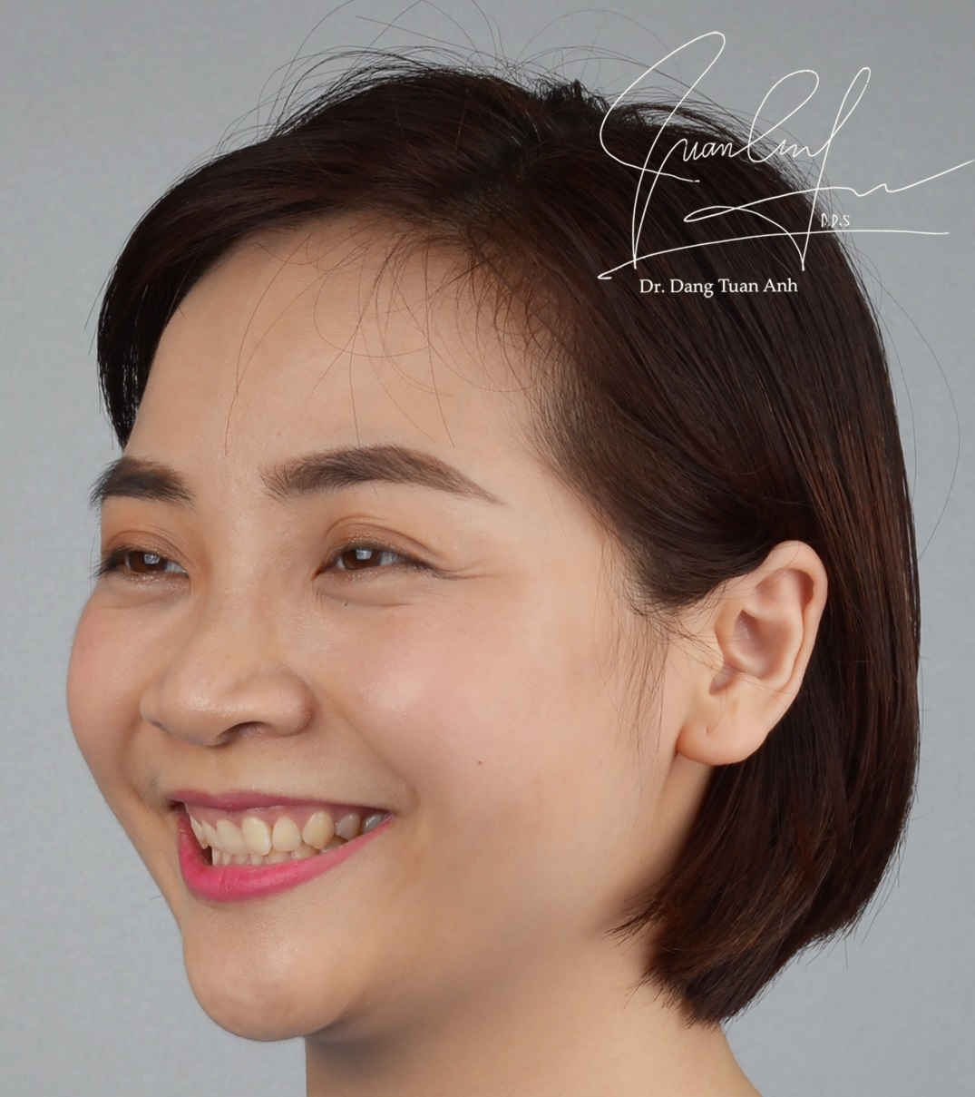
Initial situation

Slide 6
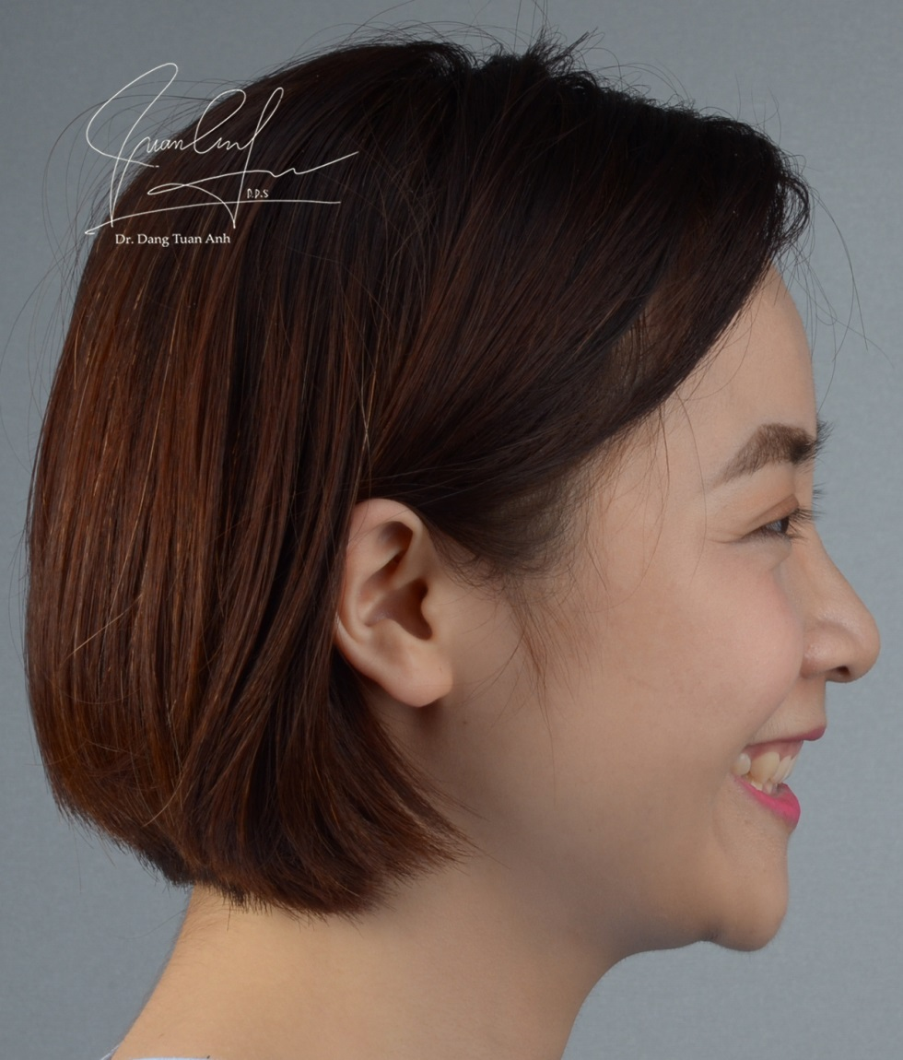
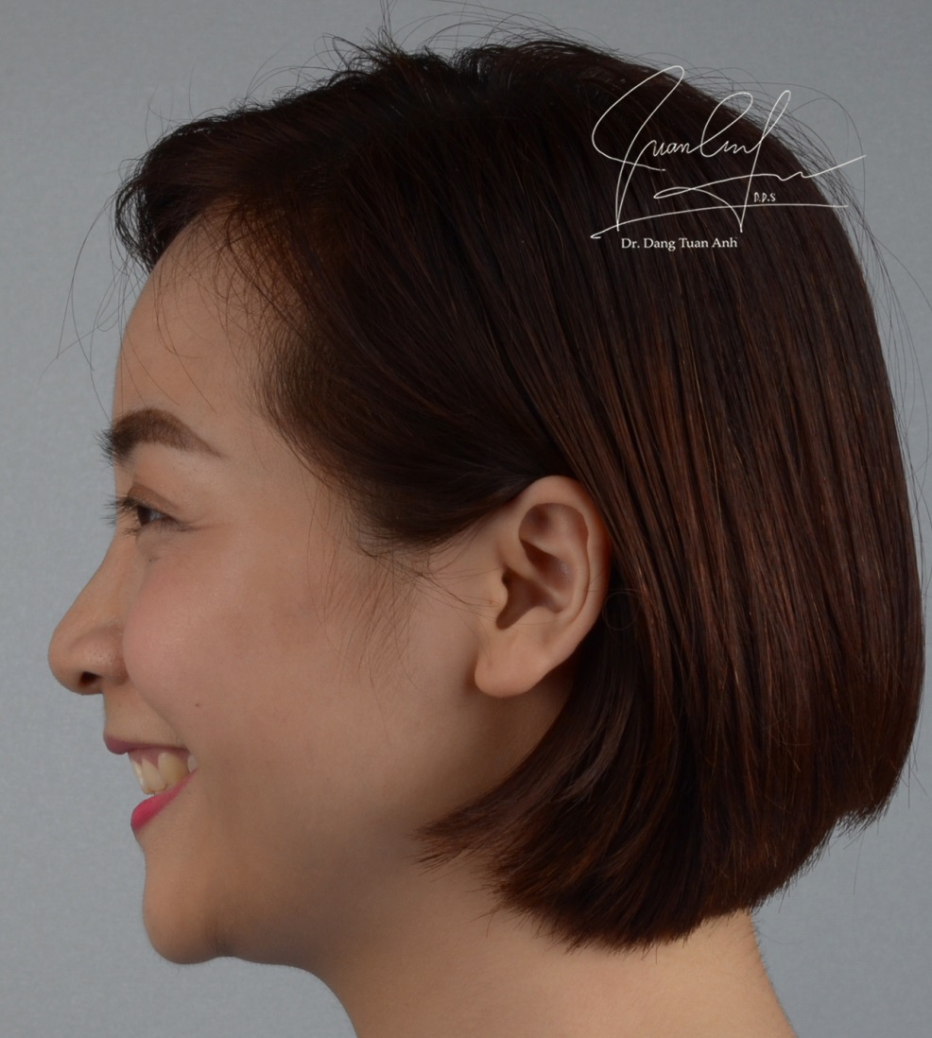
Initial situation

Slide 7
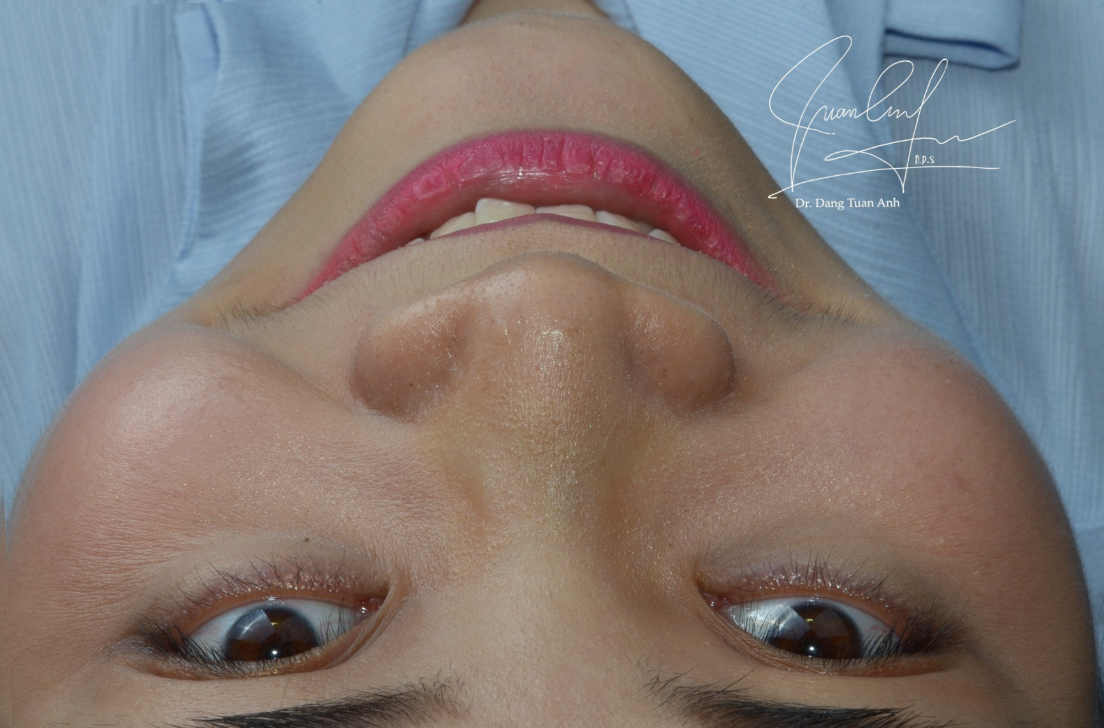
Initial situation

Slide 8
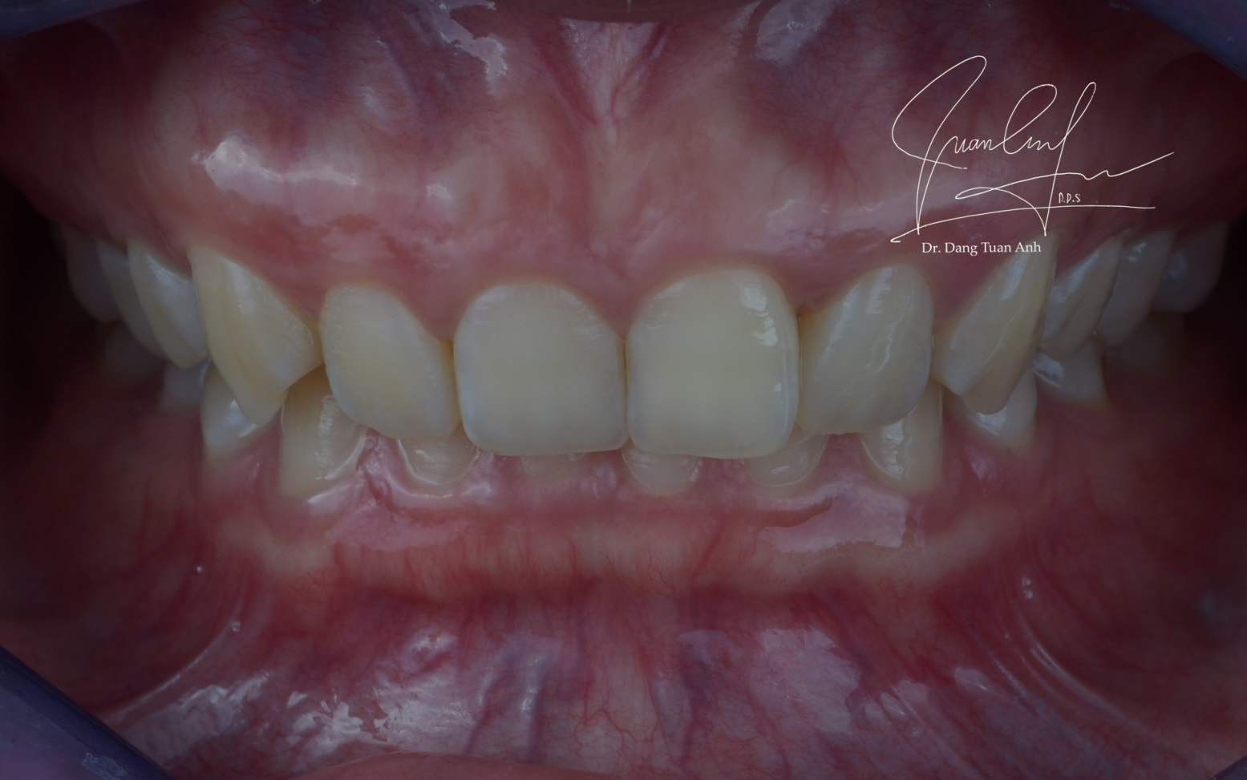
Initial situation
Initial situation
Intraoral frontal view

Slide 9
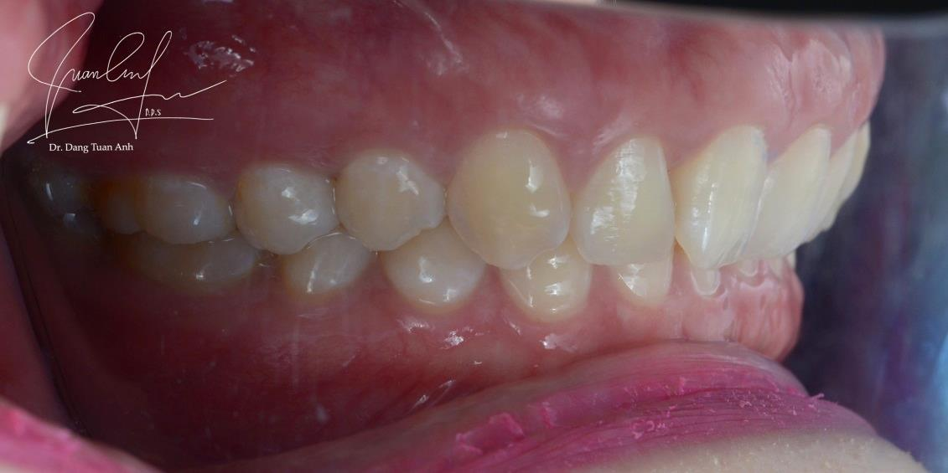
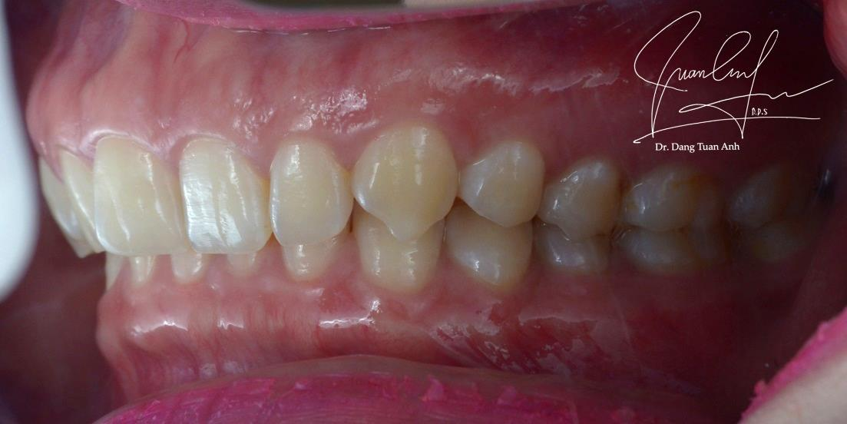
Initial situation
Intraoral lateral view

Slide 10
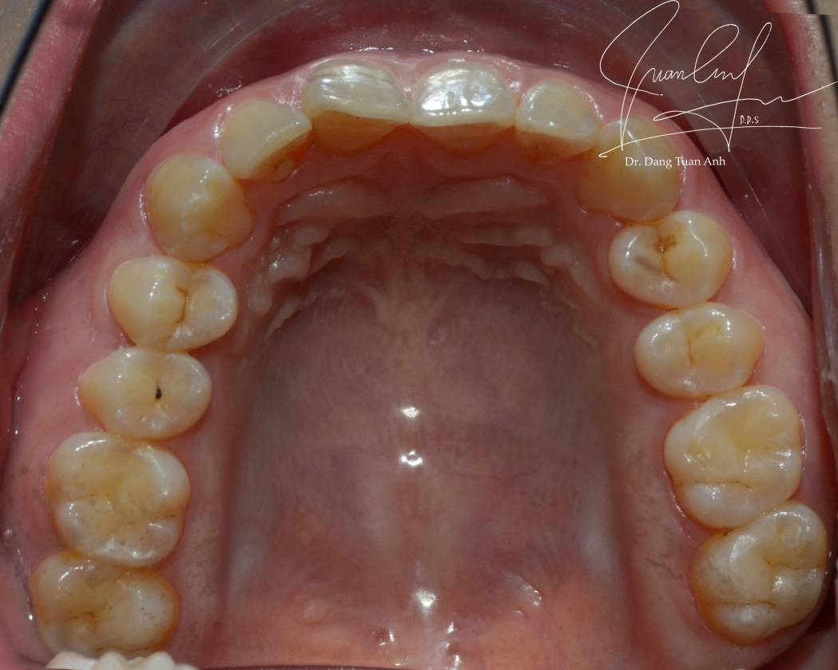
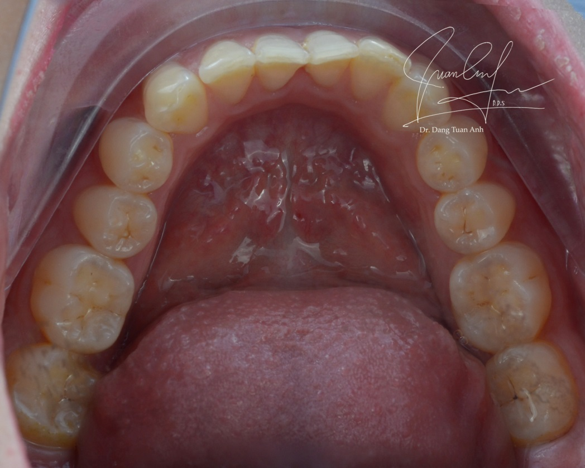
Initial situation
Intraoral occlusal view

Slide 11
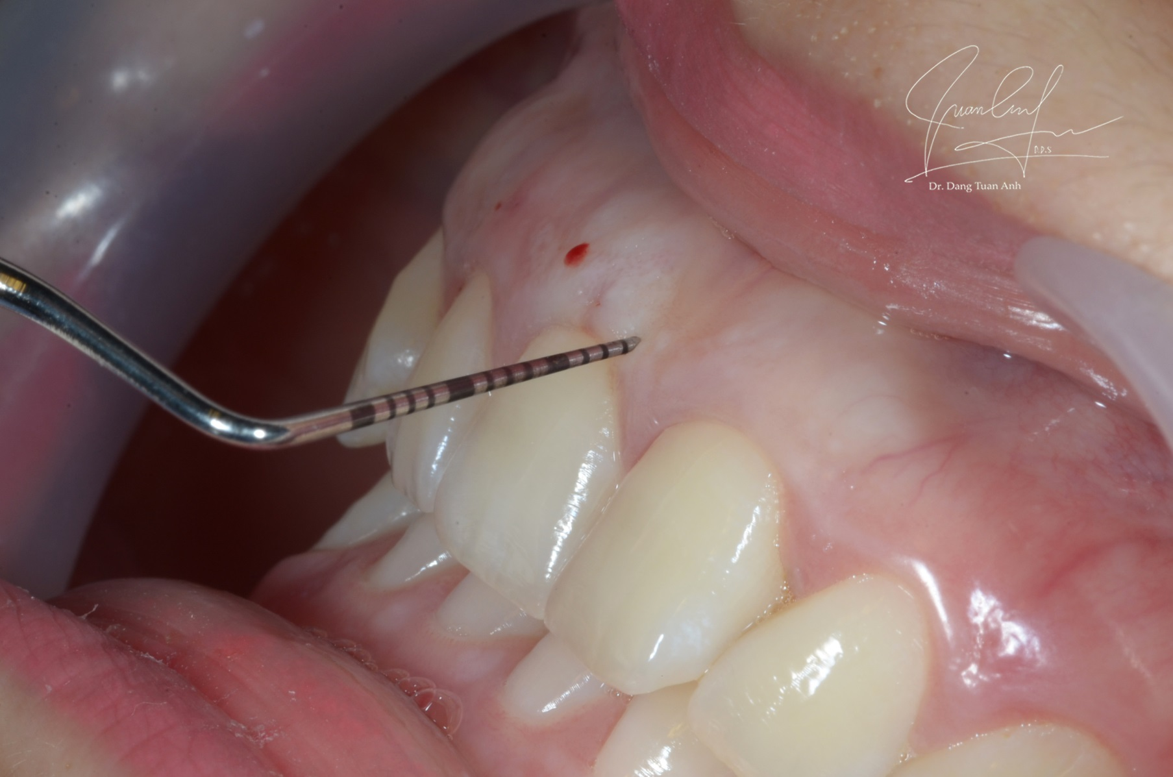
Crown lengthening surgery

Slide 12
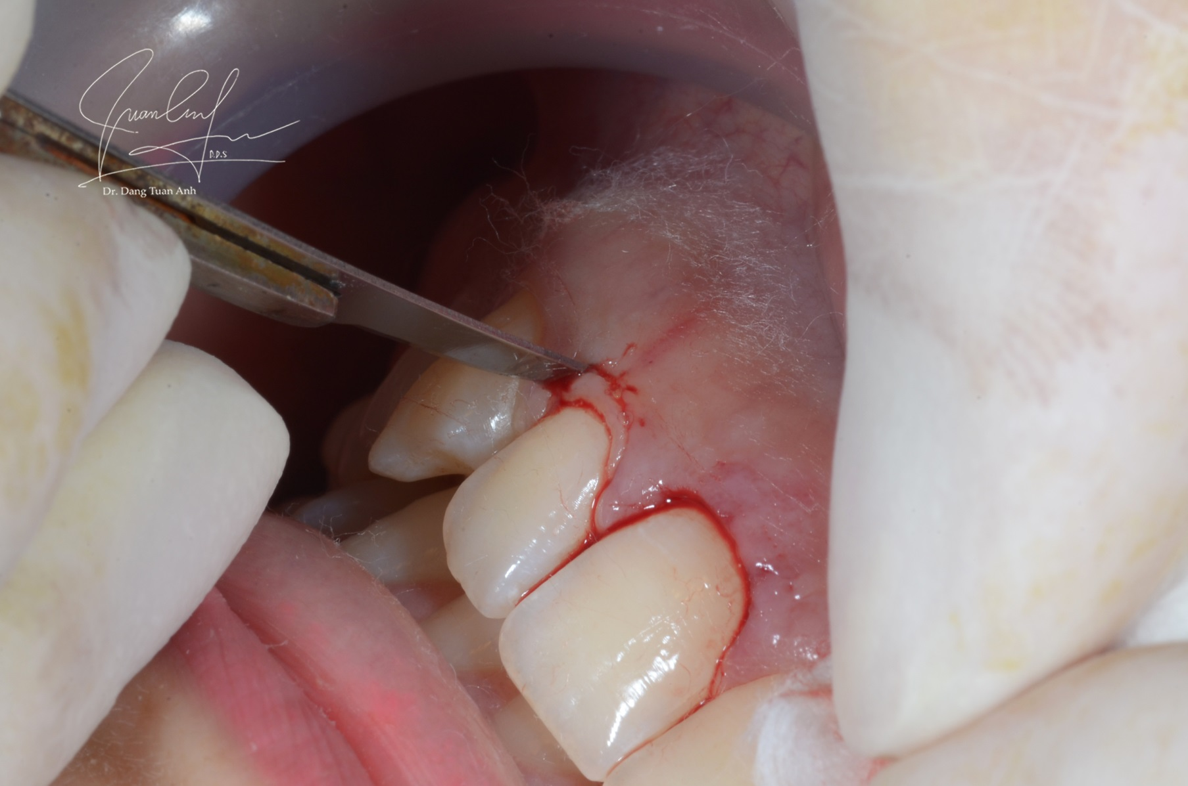

Slide 13
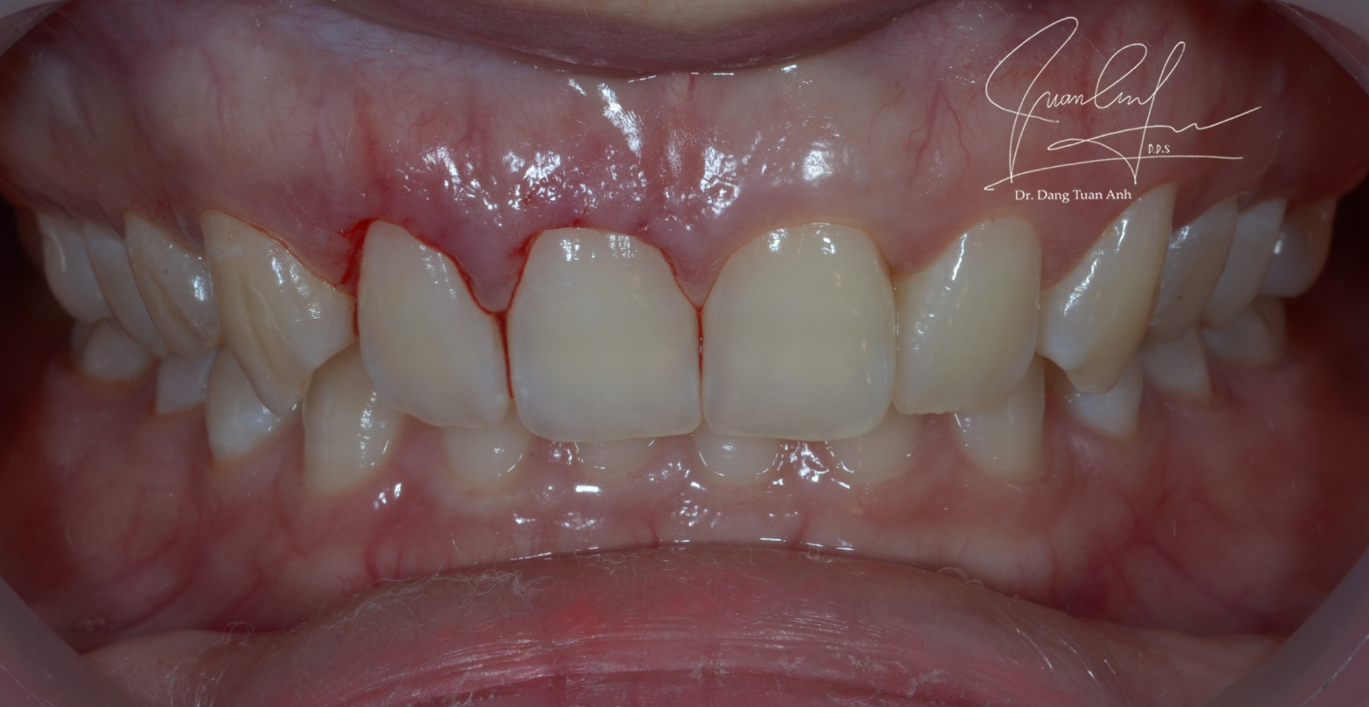
Crown lengthening surgery

Slide 14
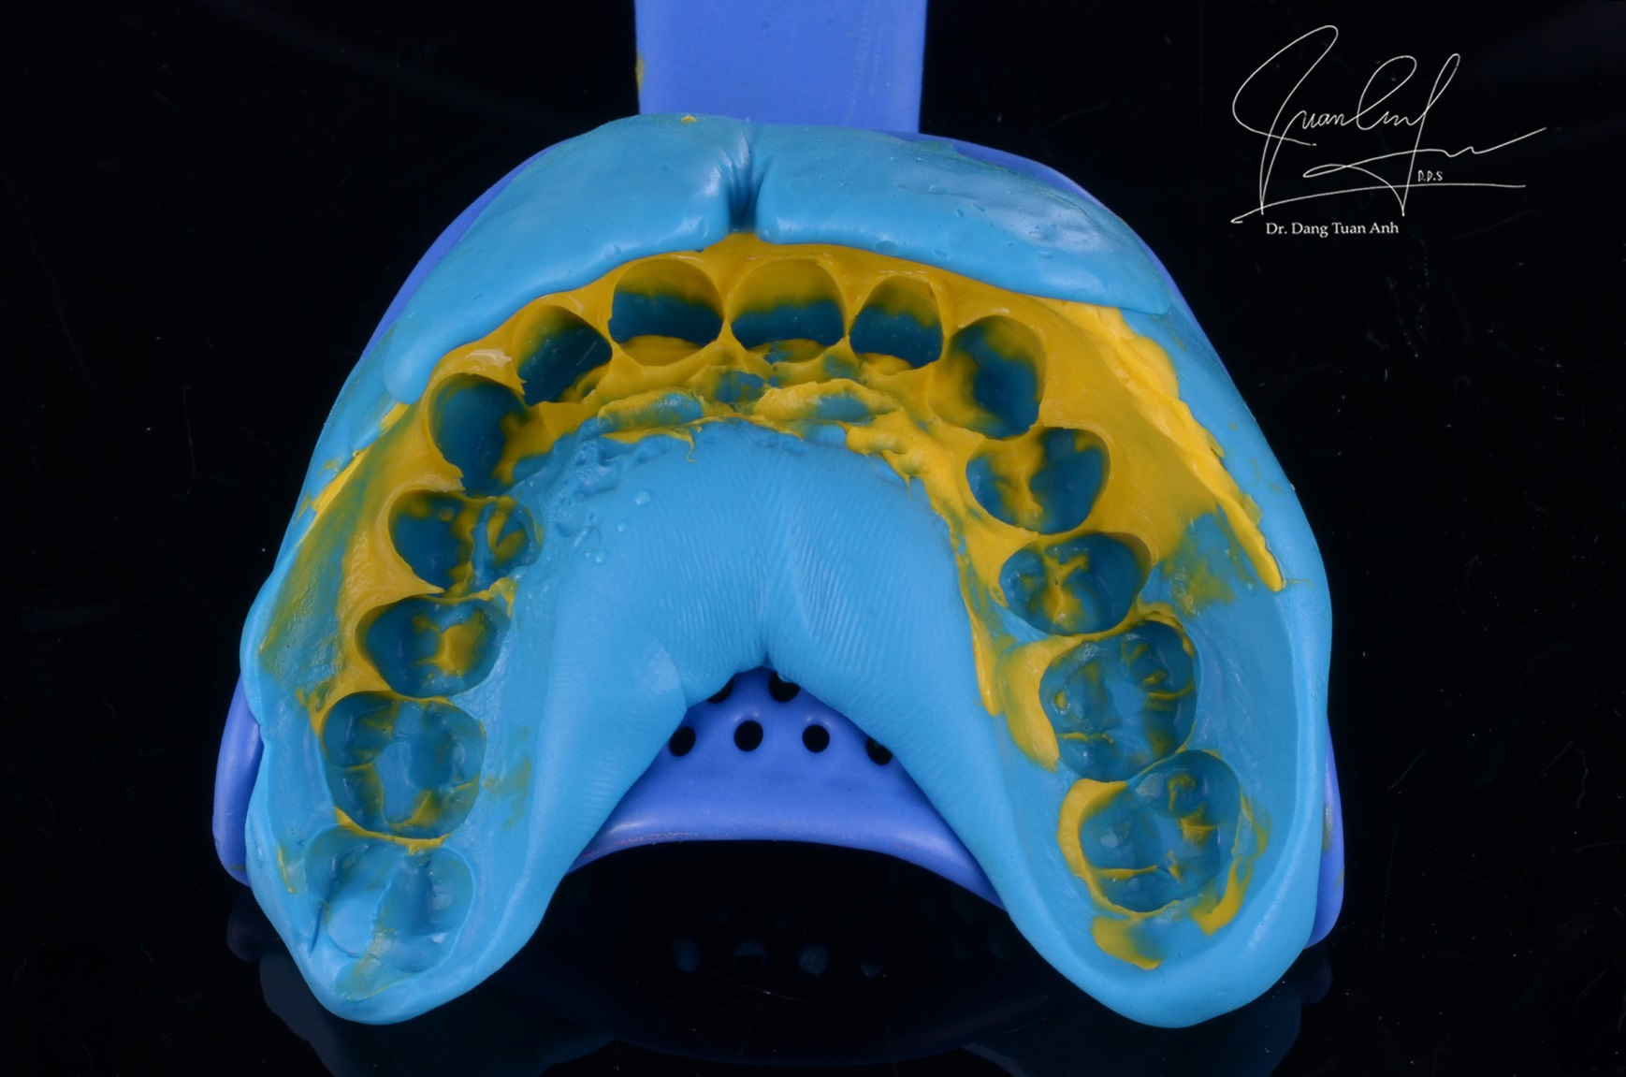
Impression after crown lengthening

Slide 15
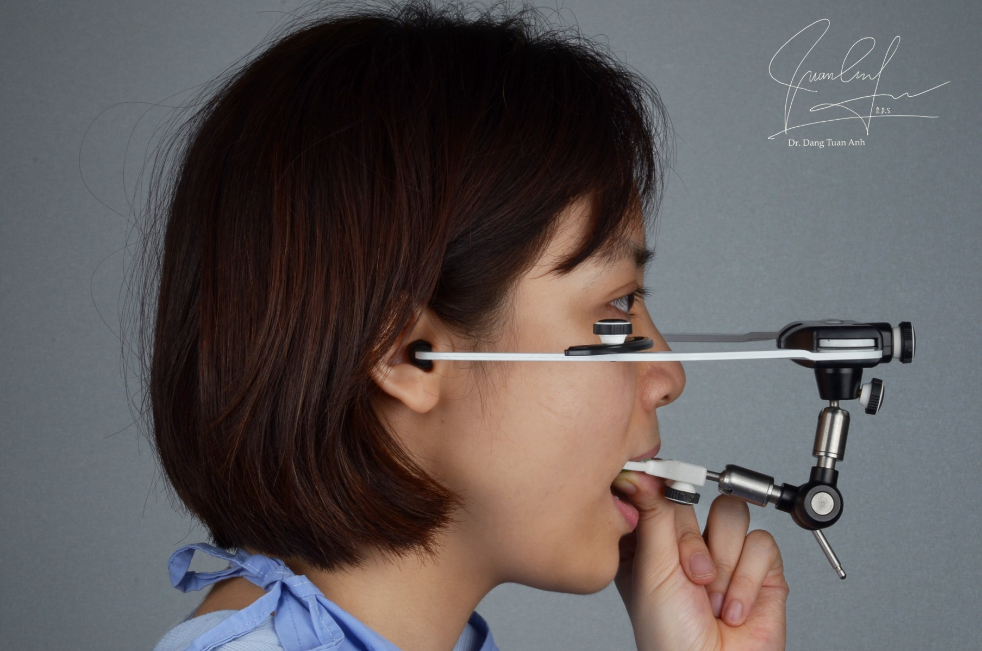
Facebow transfer + Bite registration

Slide 16
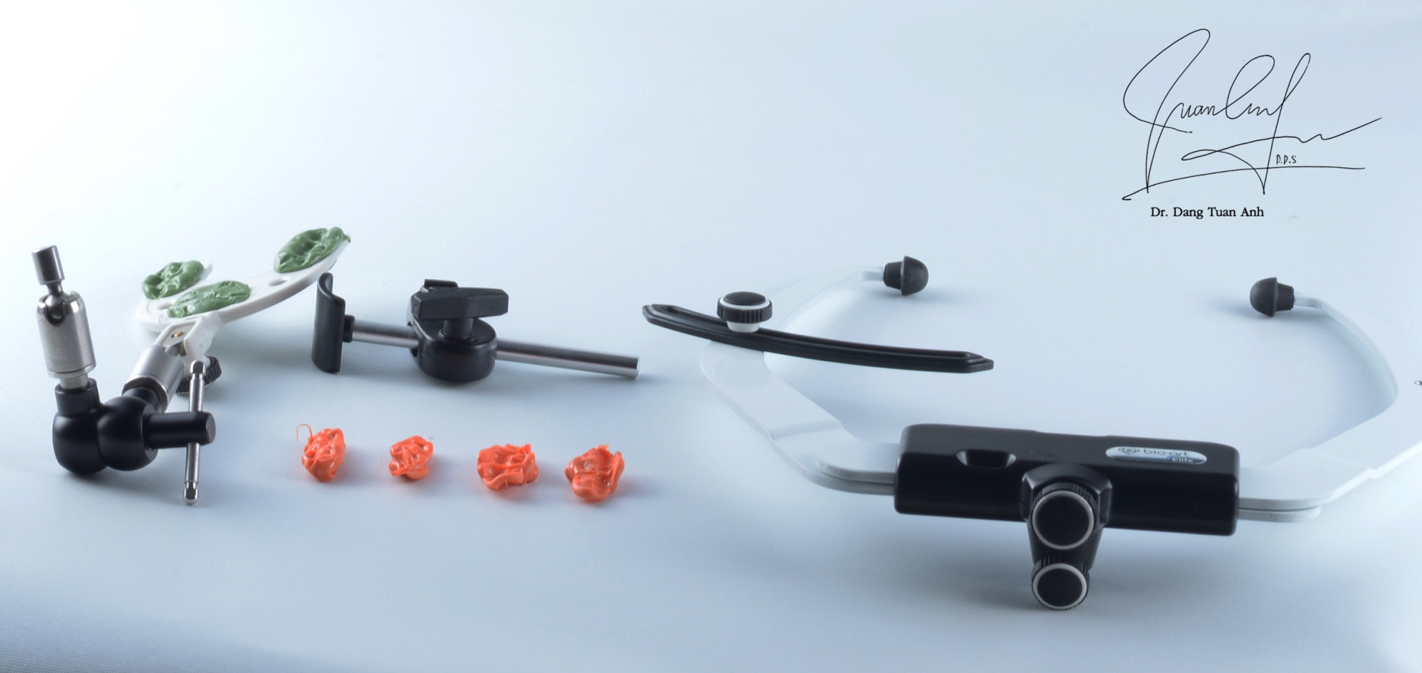
Facebow transfer + Bite registration

Slide 17
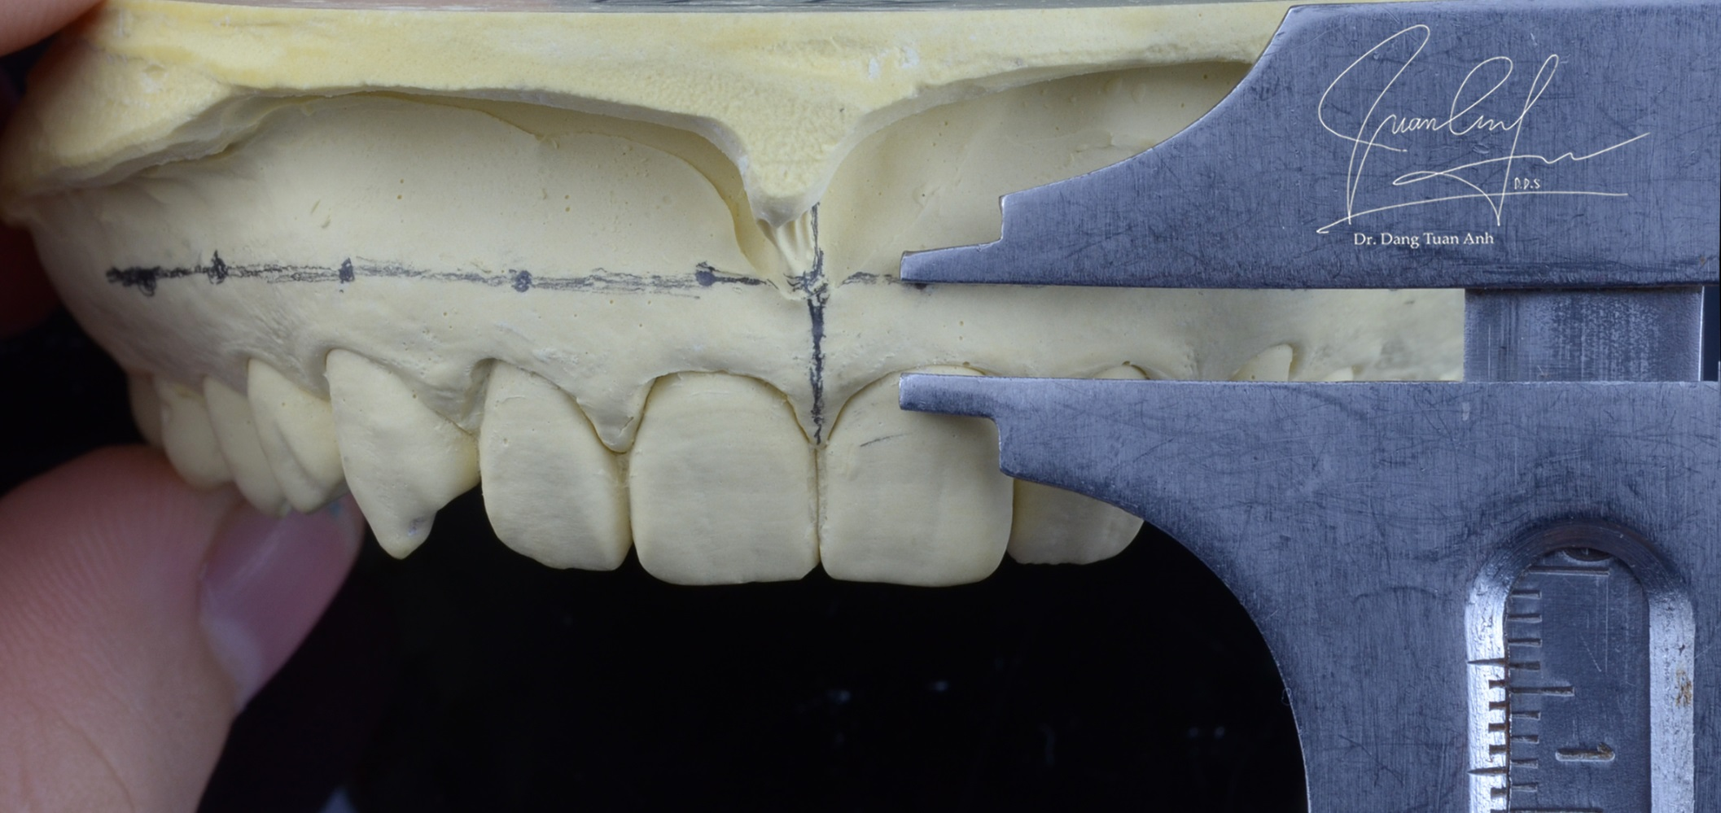
Measurement on the cast

Slide 18
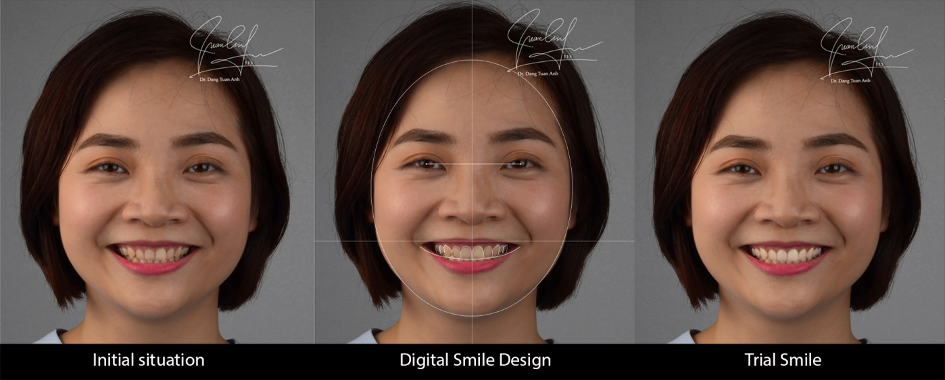
Digital Smile Design

Slide 19
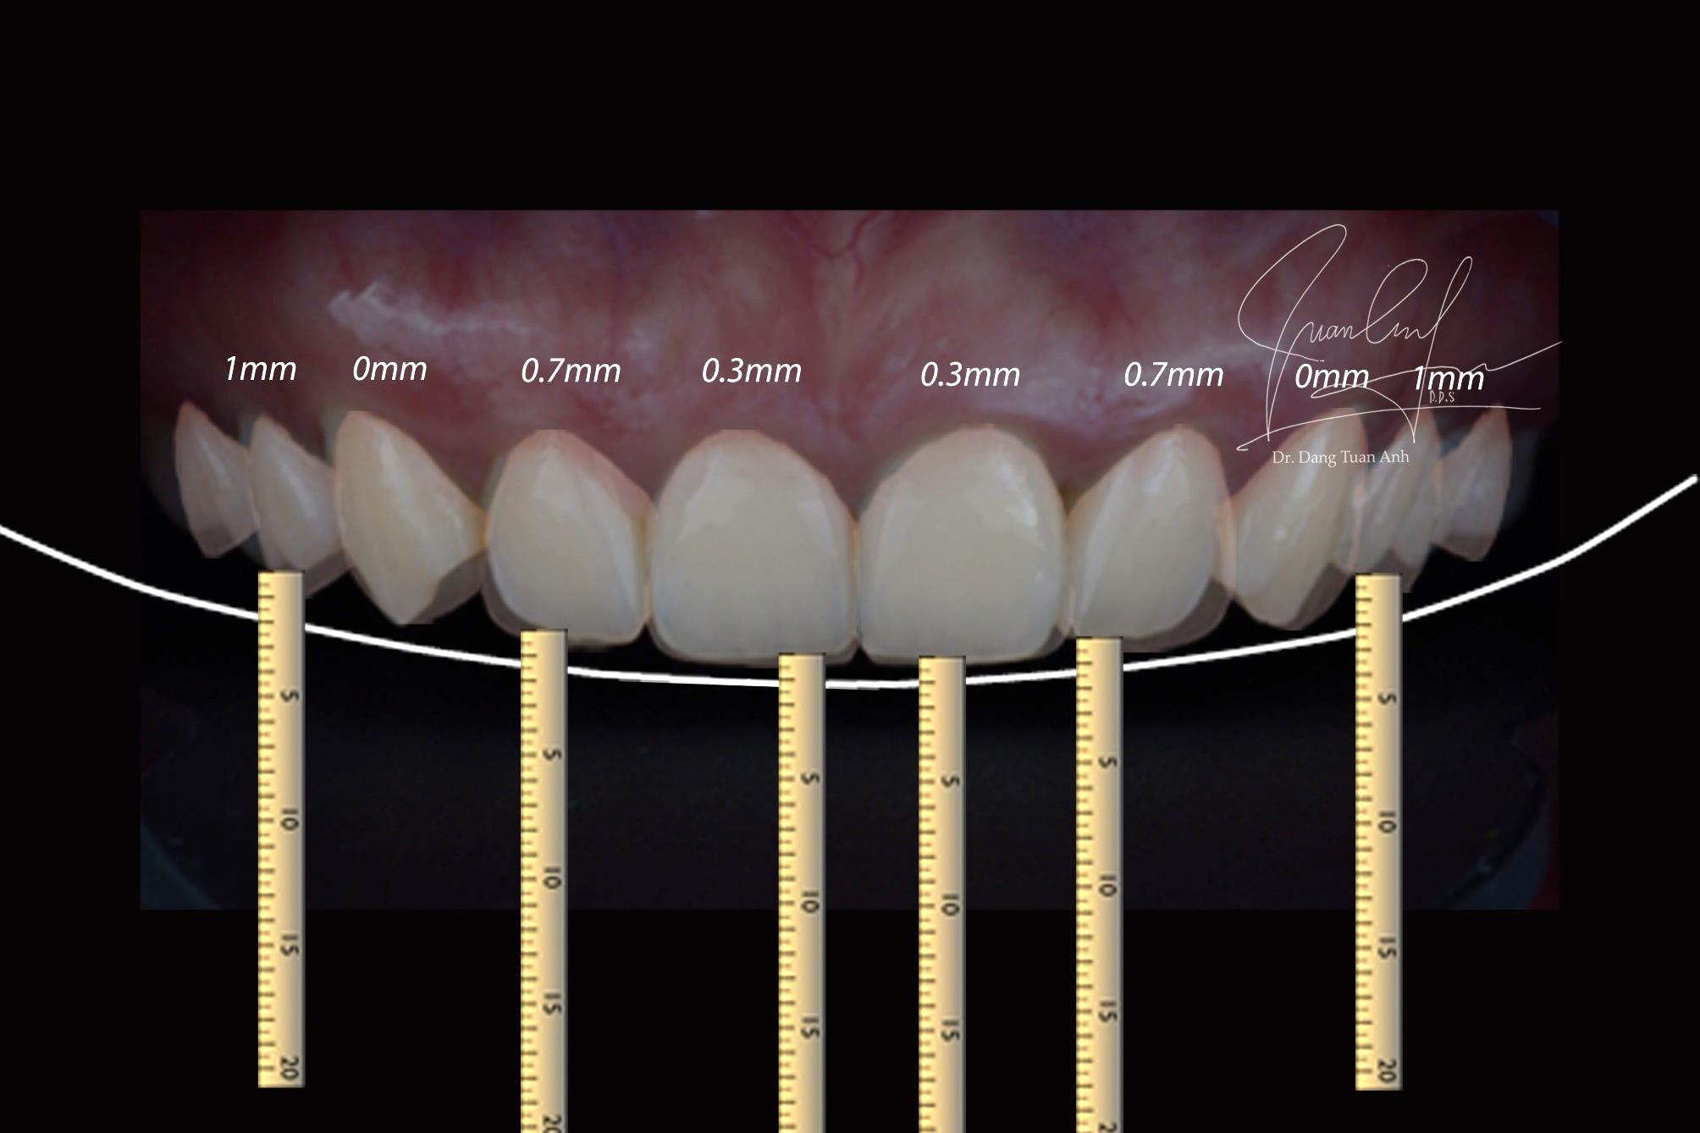
Digital Smile Design to communicate with technician

Slide 20
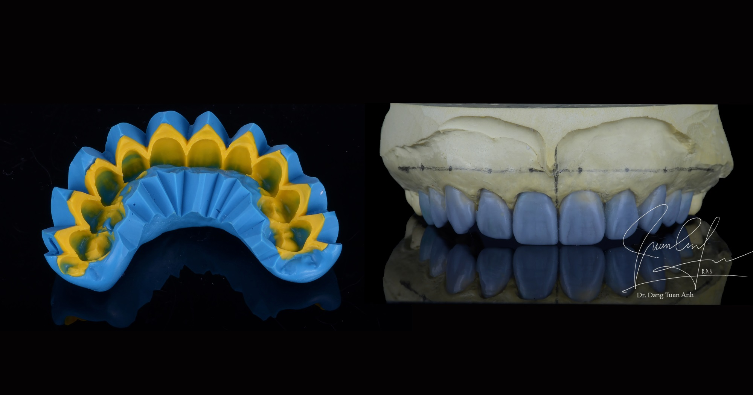
Silicone key – Wax up

Slide 21
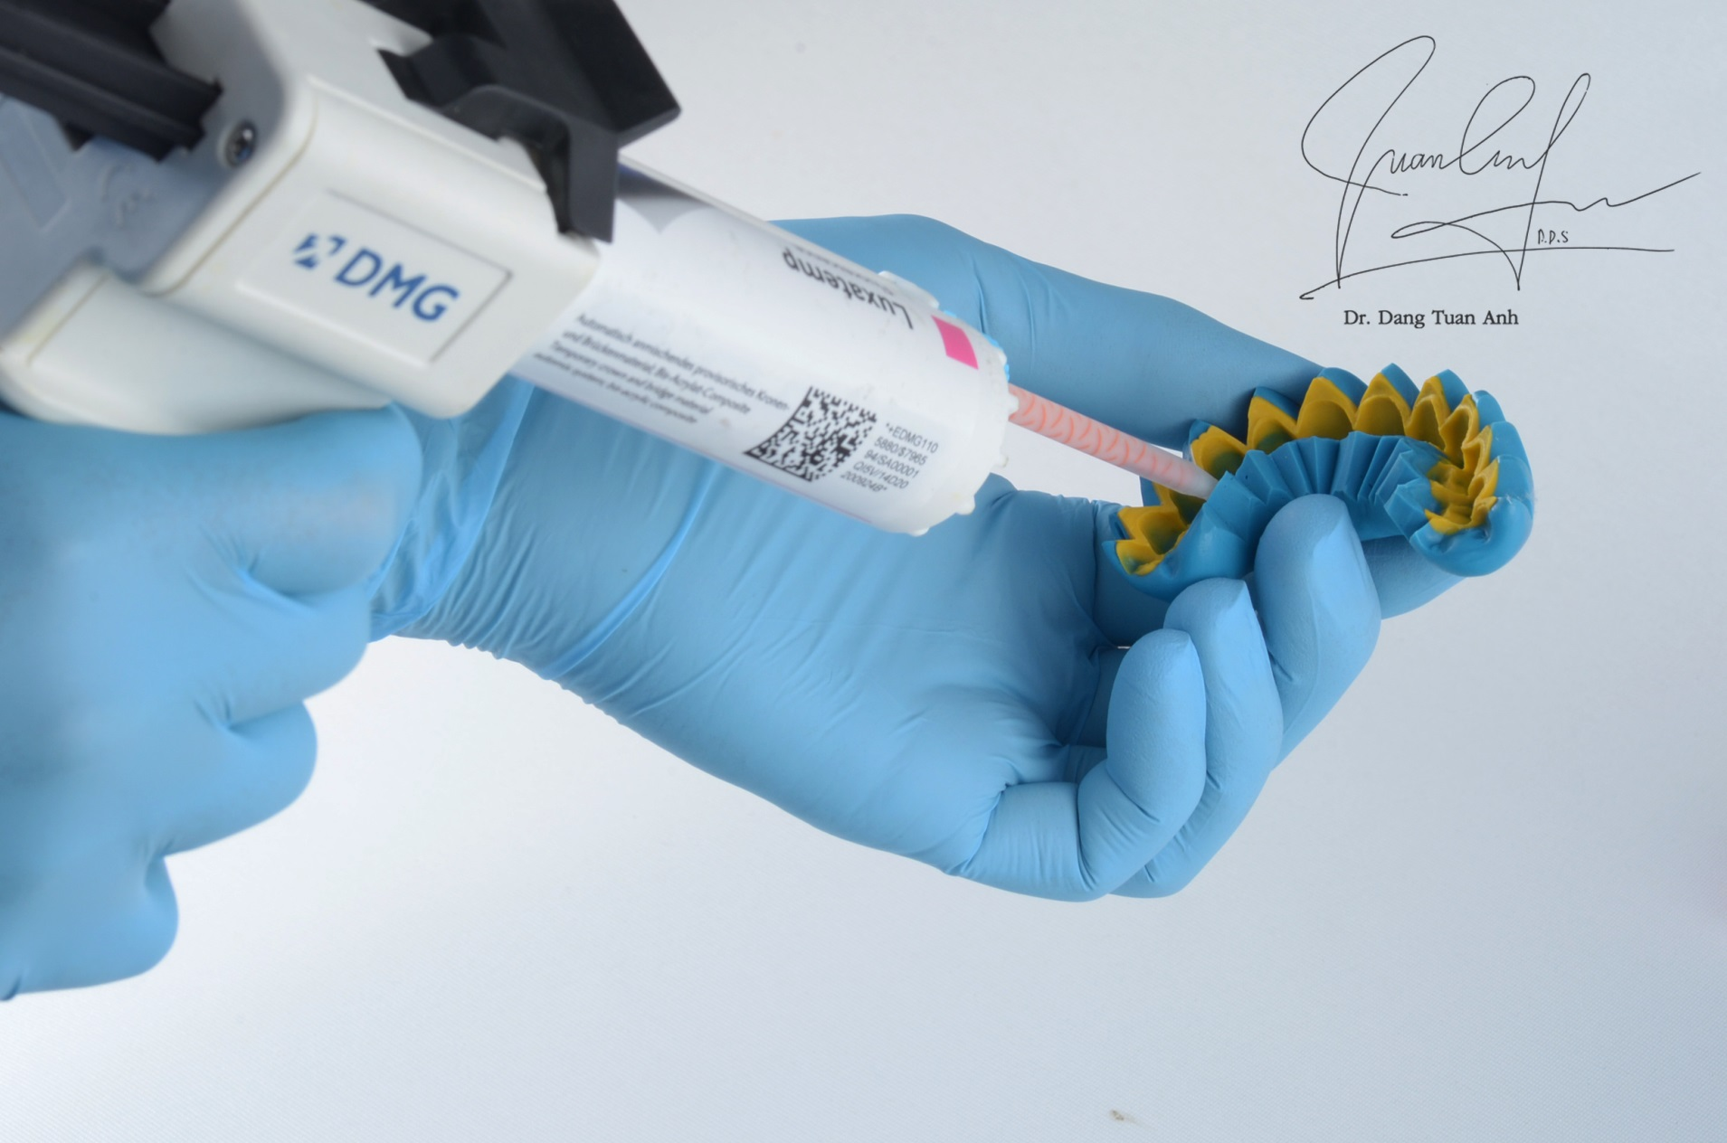

Slide 22
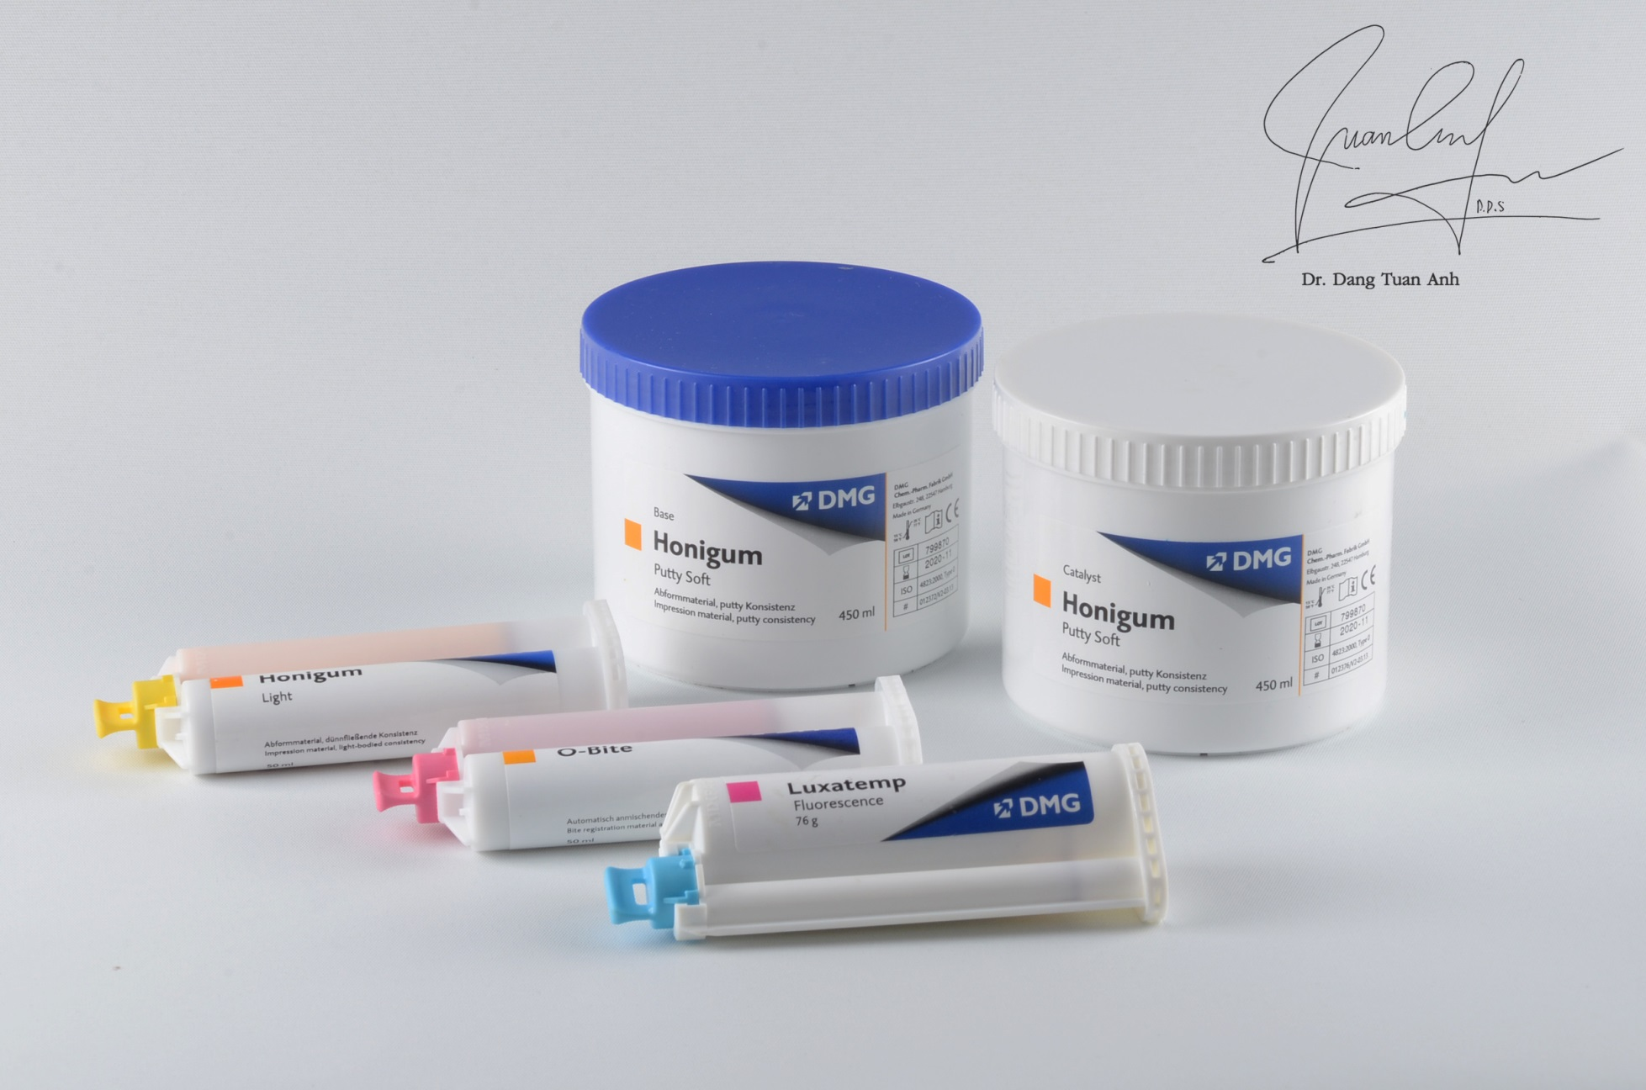

Slide 23
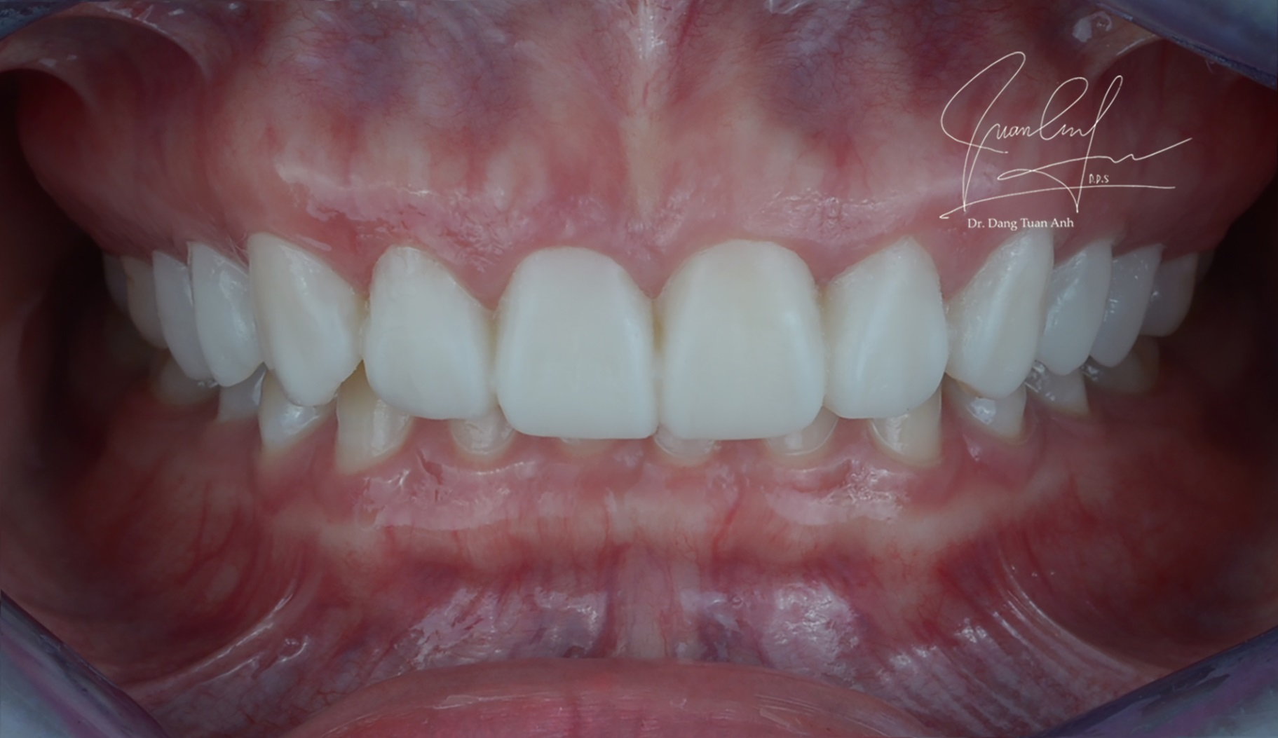
Intraoral Mock up

Slide 24
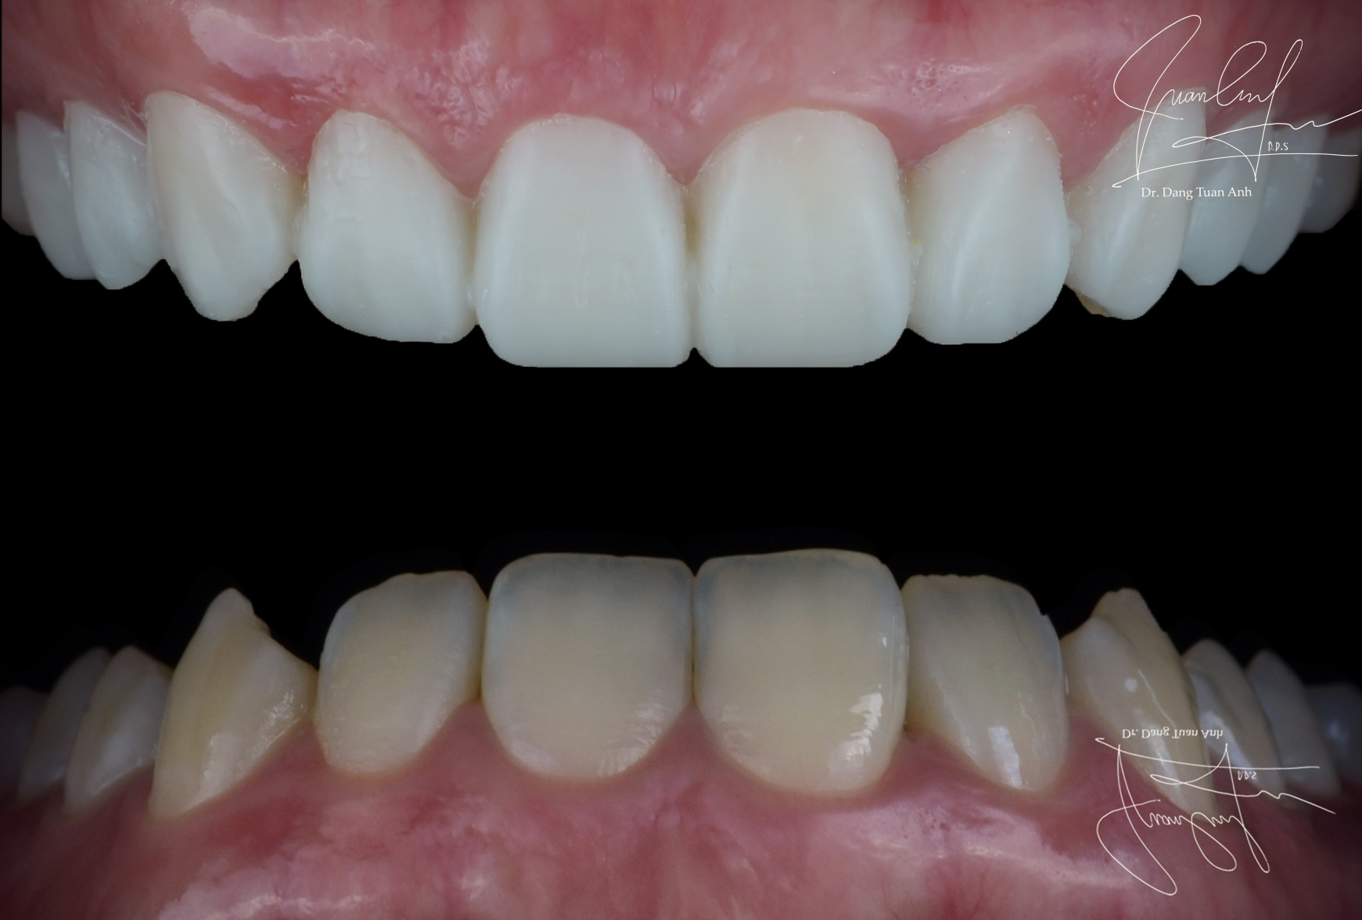
Intraoral Mock up

Slide 25
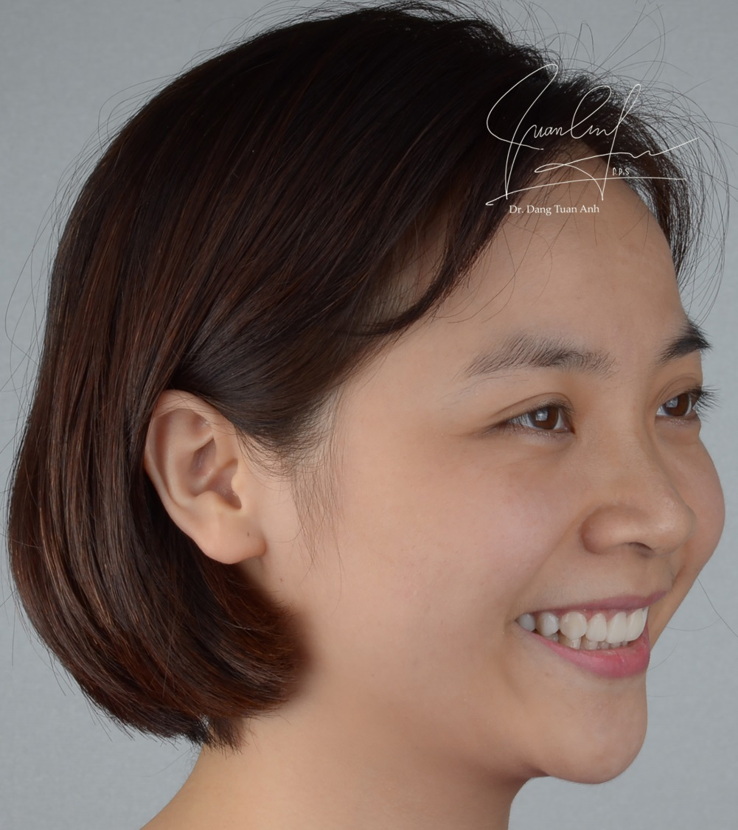
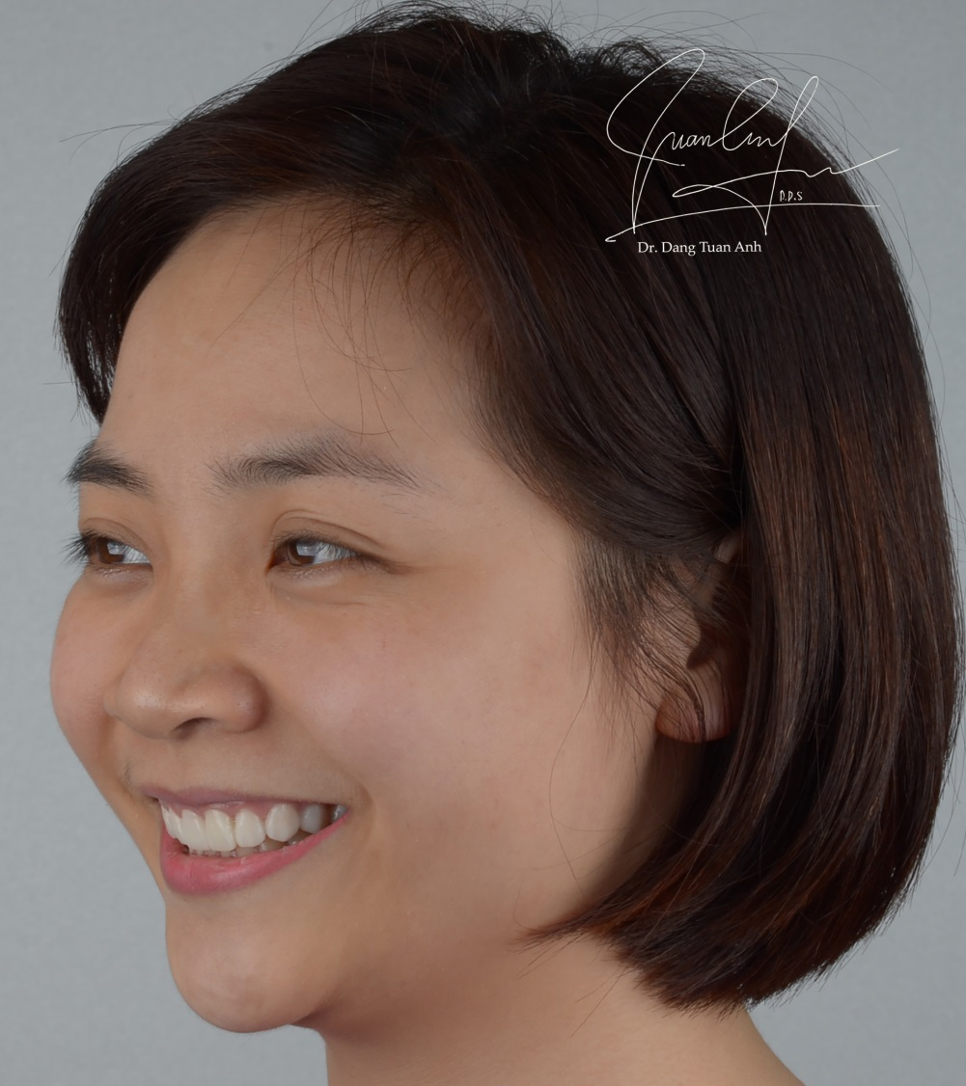
Mock up 45⁰

Slide 26
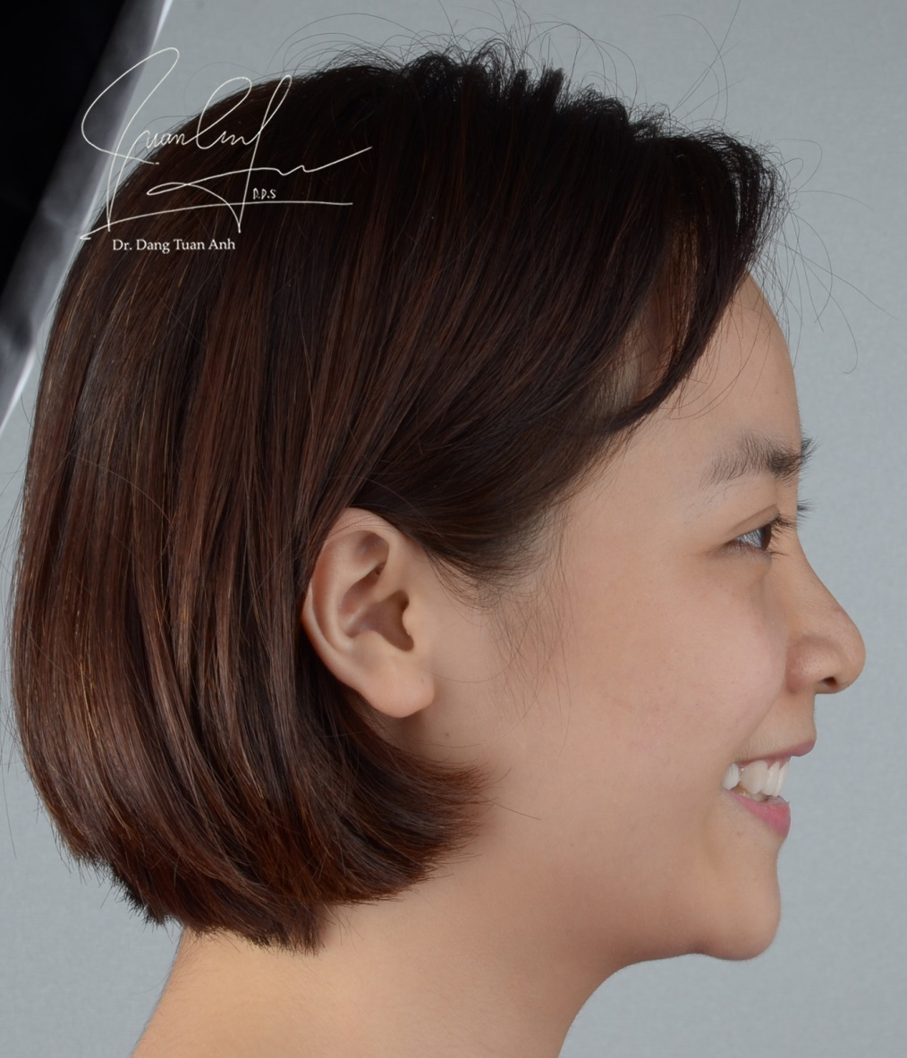
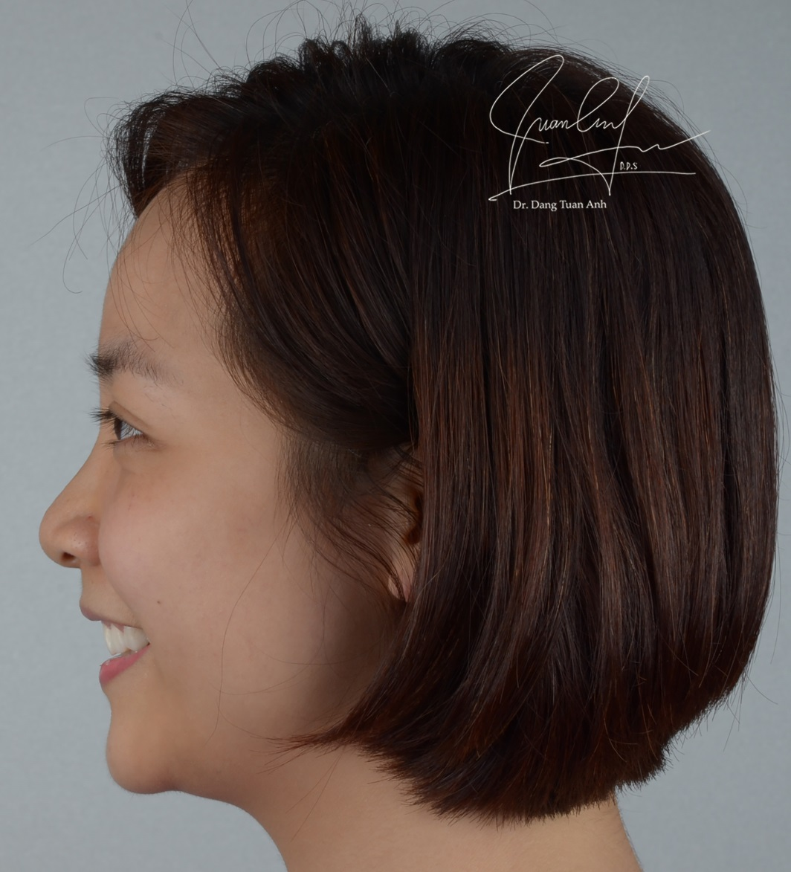
Mock up 90⁰

Slide 27
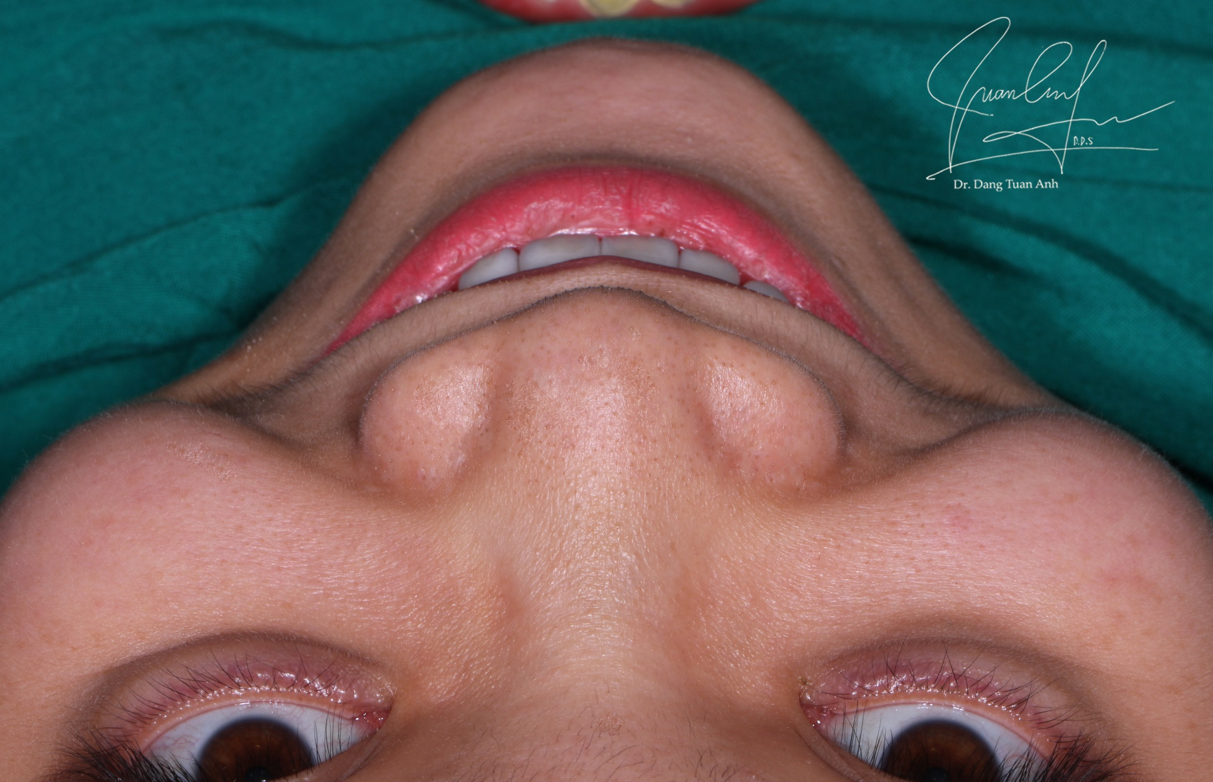
Mock-up at the 12h position

Slide 28
12h position before - after

Slide 29
Mock up Frontal smile

Slide 30
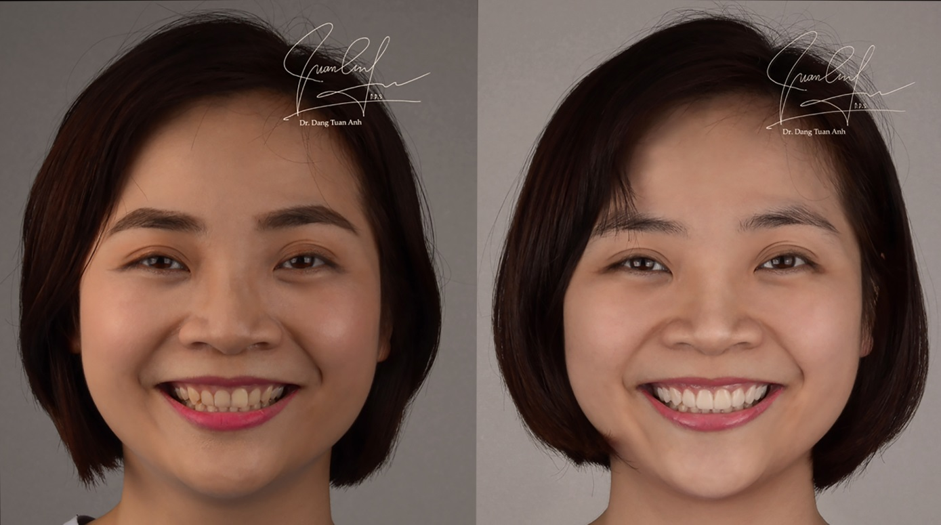
Before
After

Slide 31
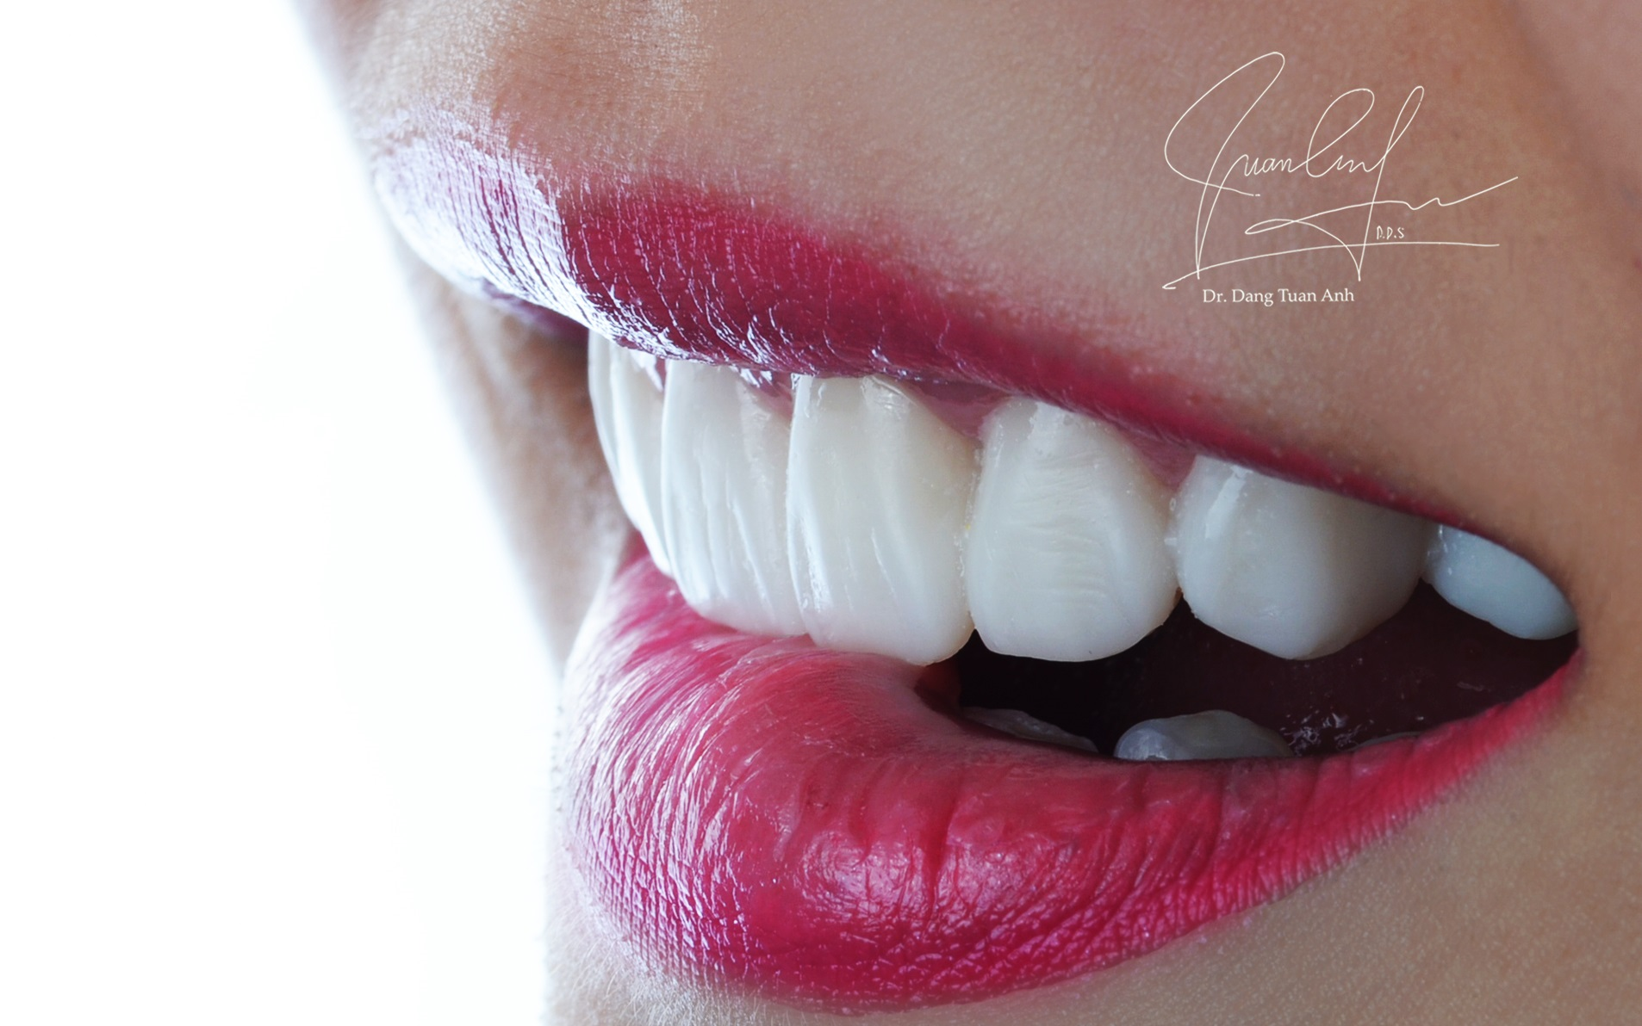
Artistic

Slide 32
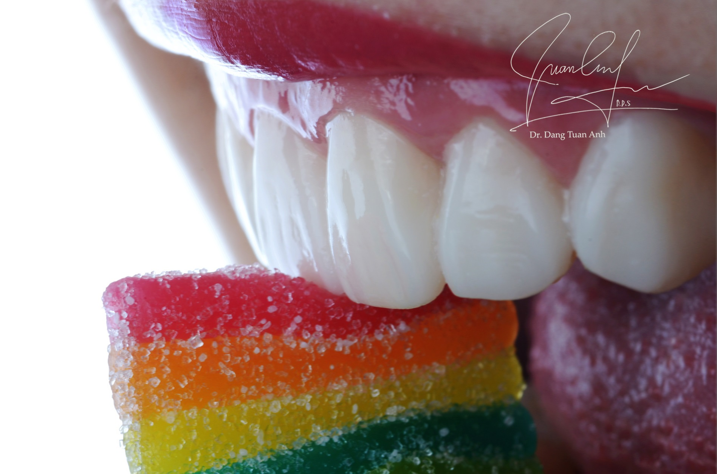
Artistic

Slide 33
Portrait picture with Mock-up

Slide 34
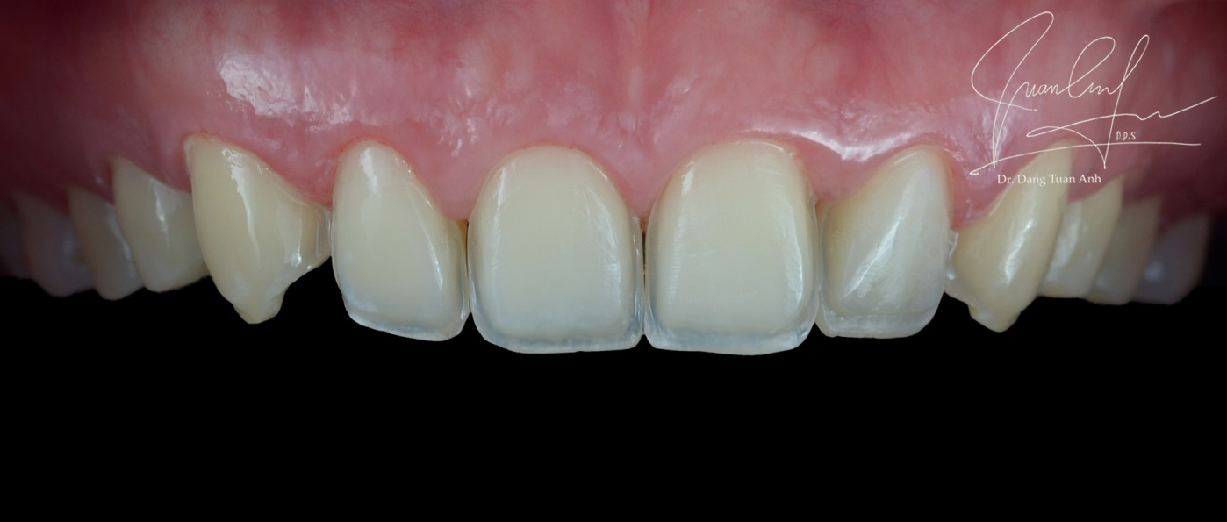
Preparation

Slide 35
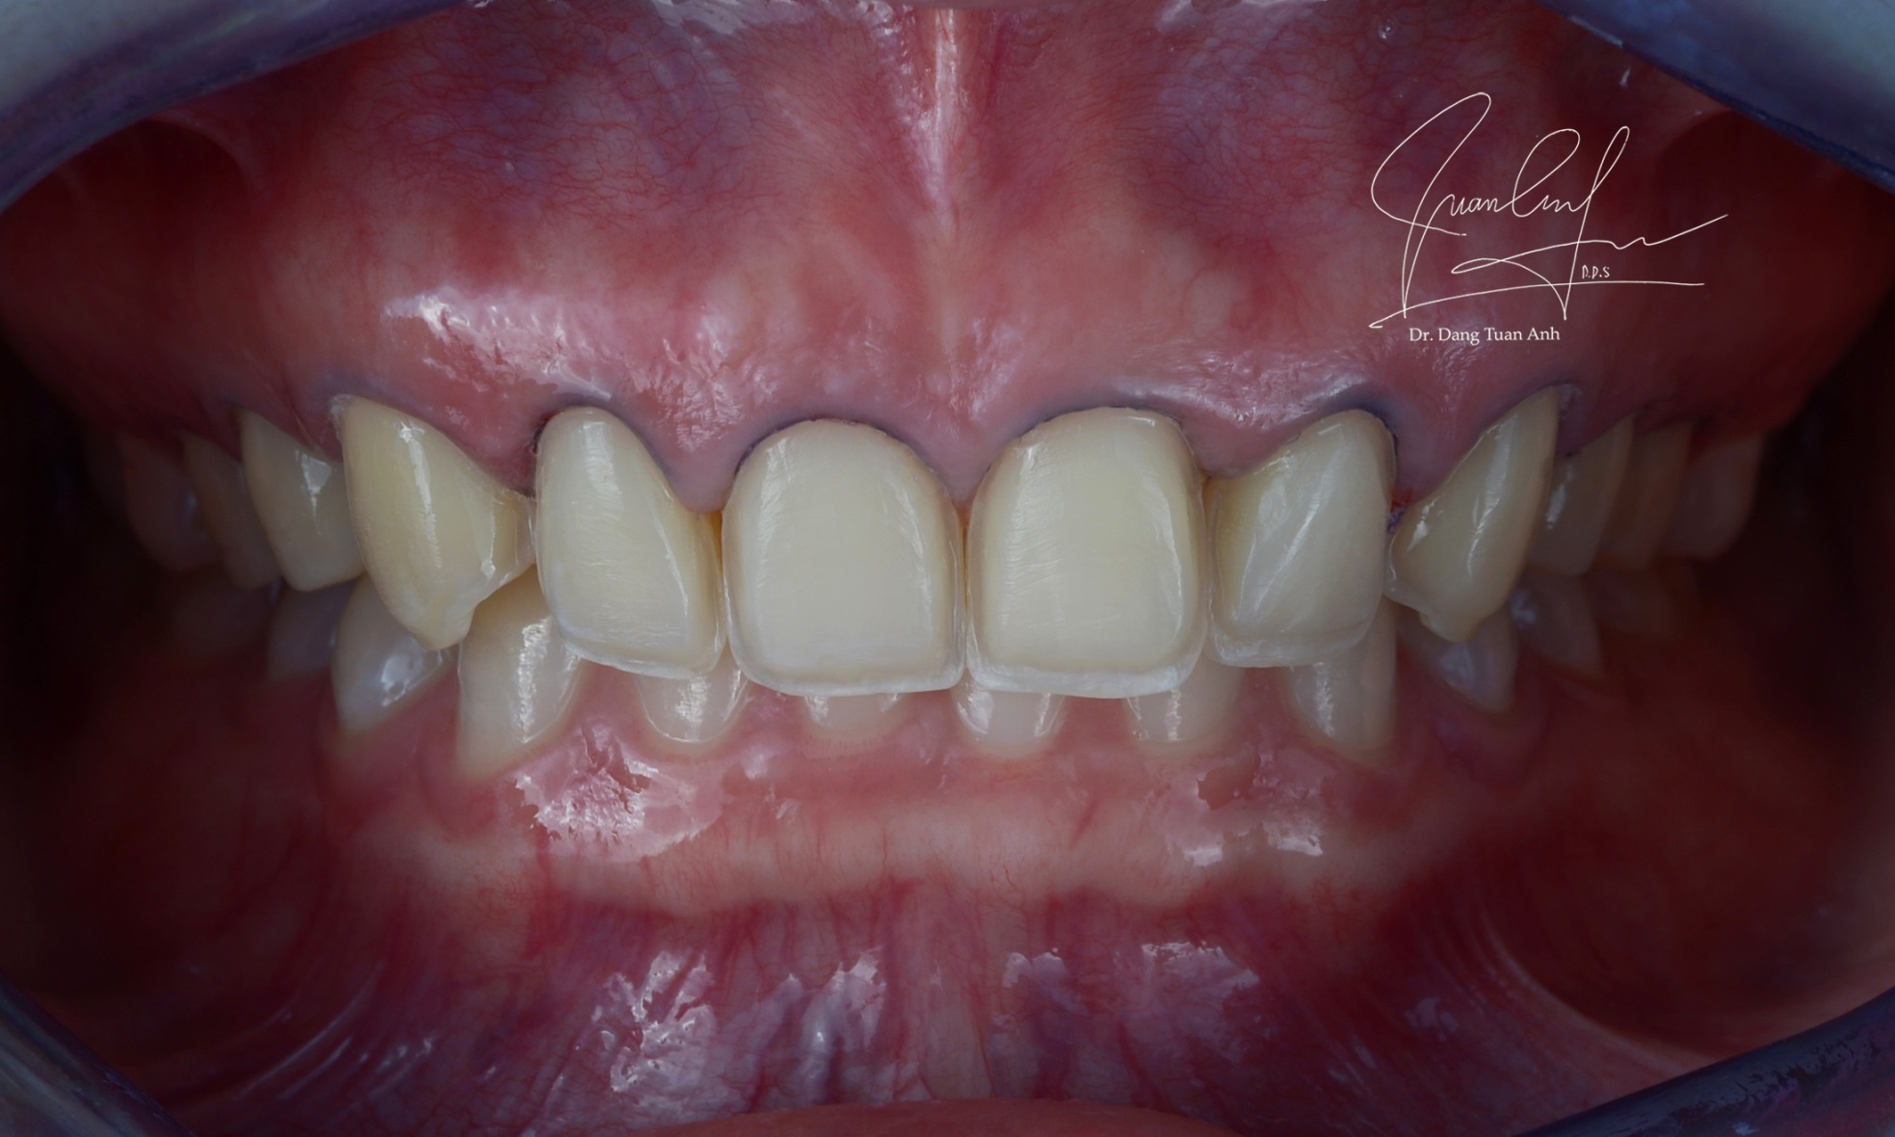
Retraction cord

Slide 36
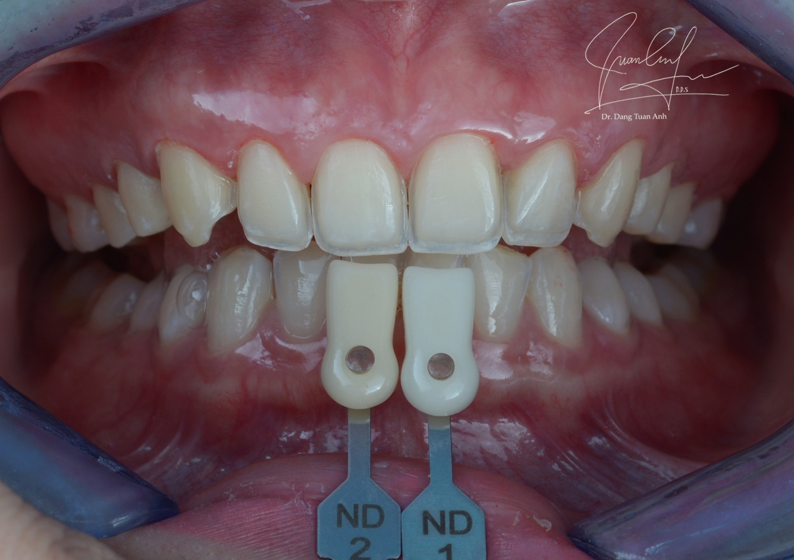
Shade matching

Slide 37
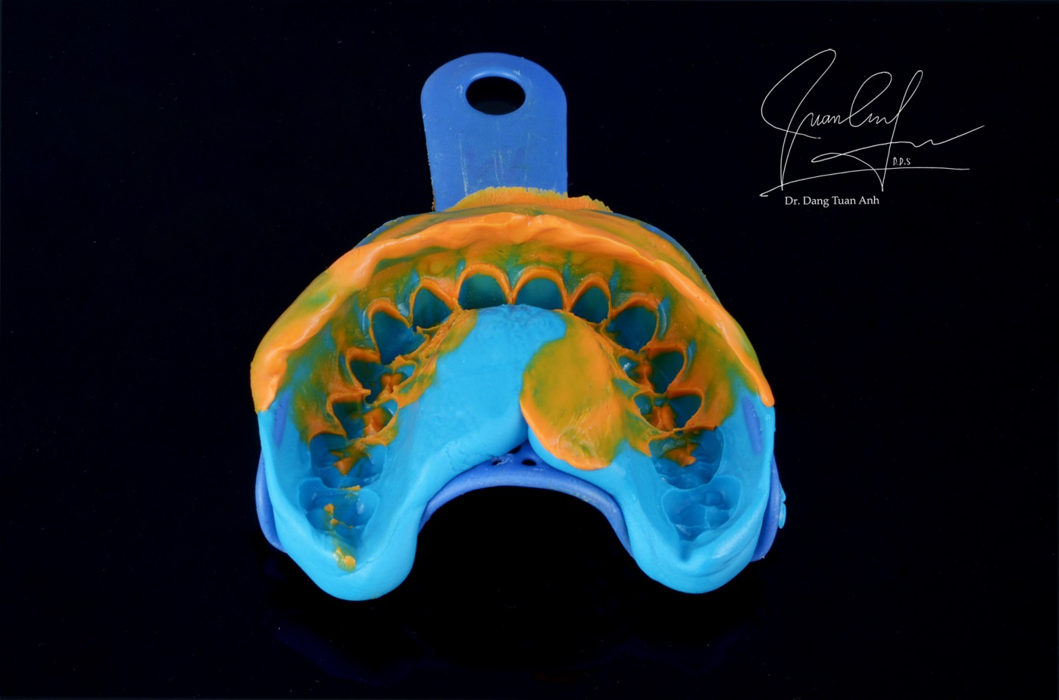
Silicone impression

Slide 38
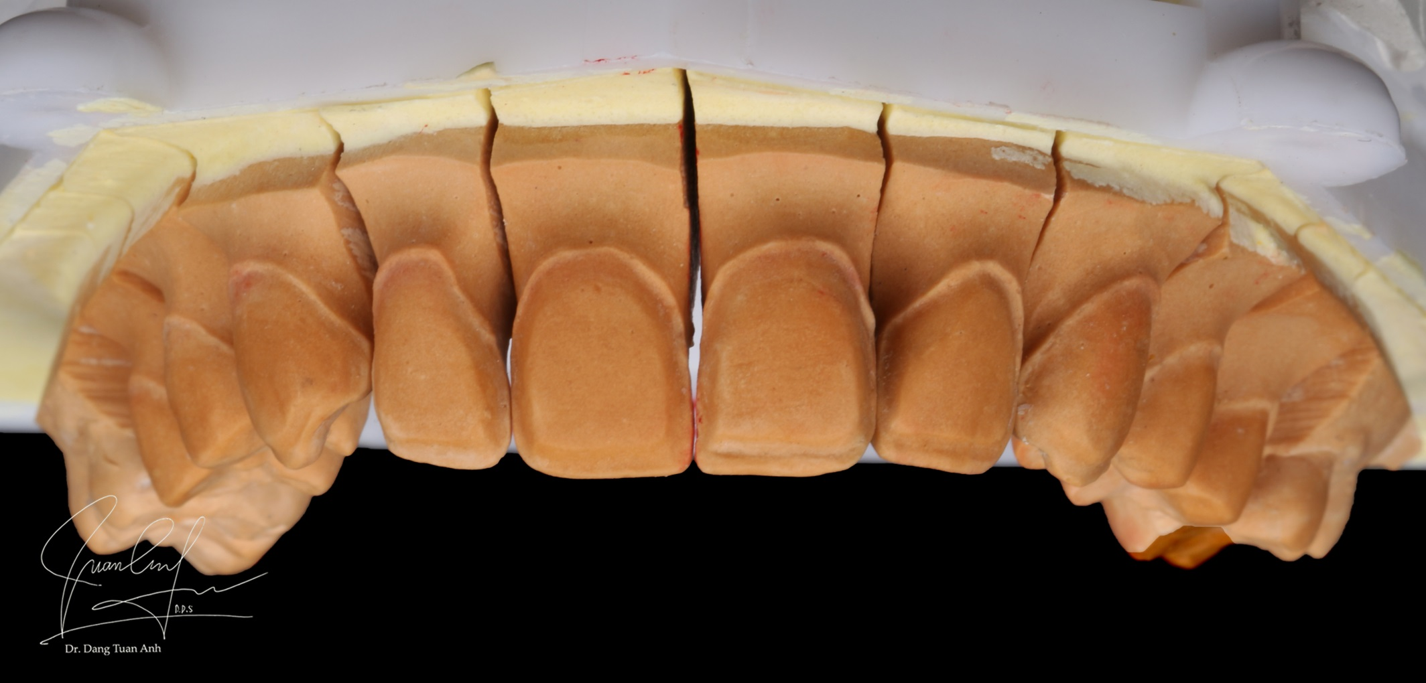
Plaster model

Slide 39
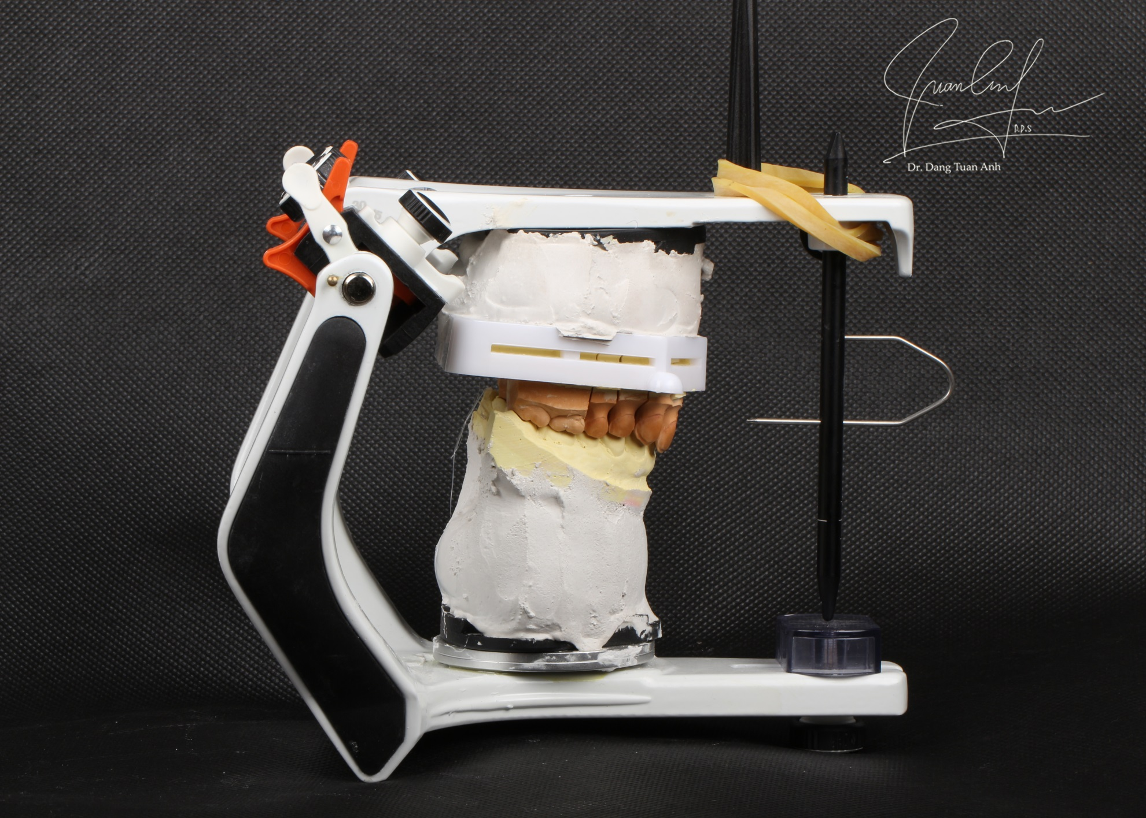
Mounting cast on the articulator

Slide 40
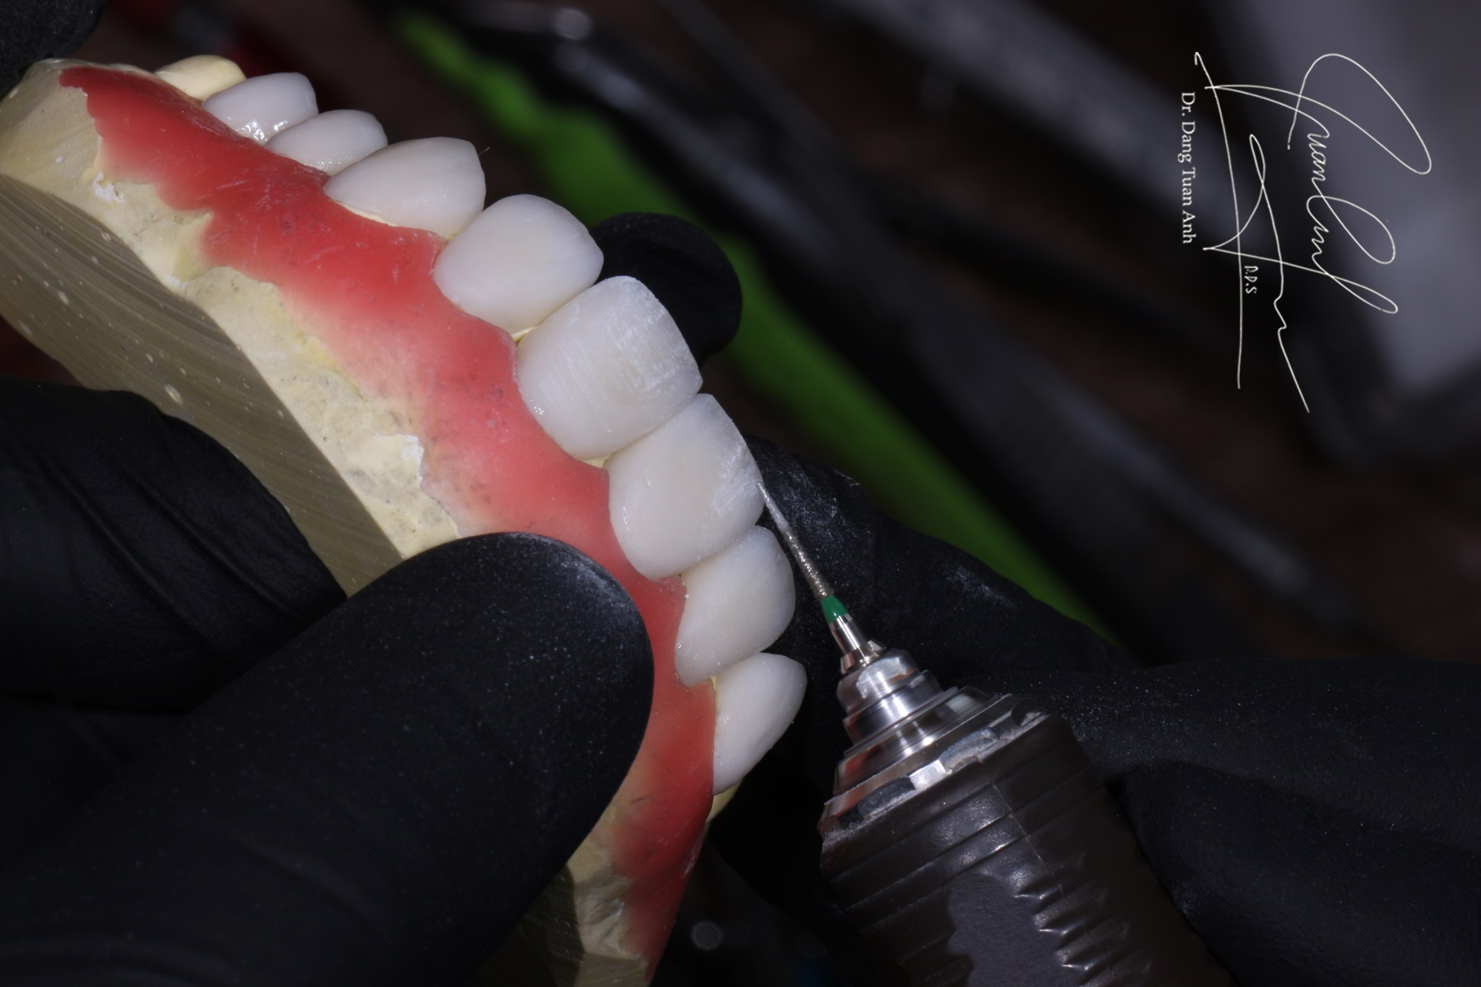
Laboratory procedure

Slide 41
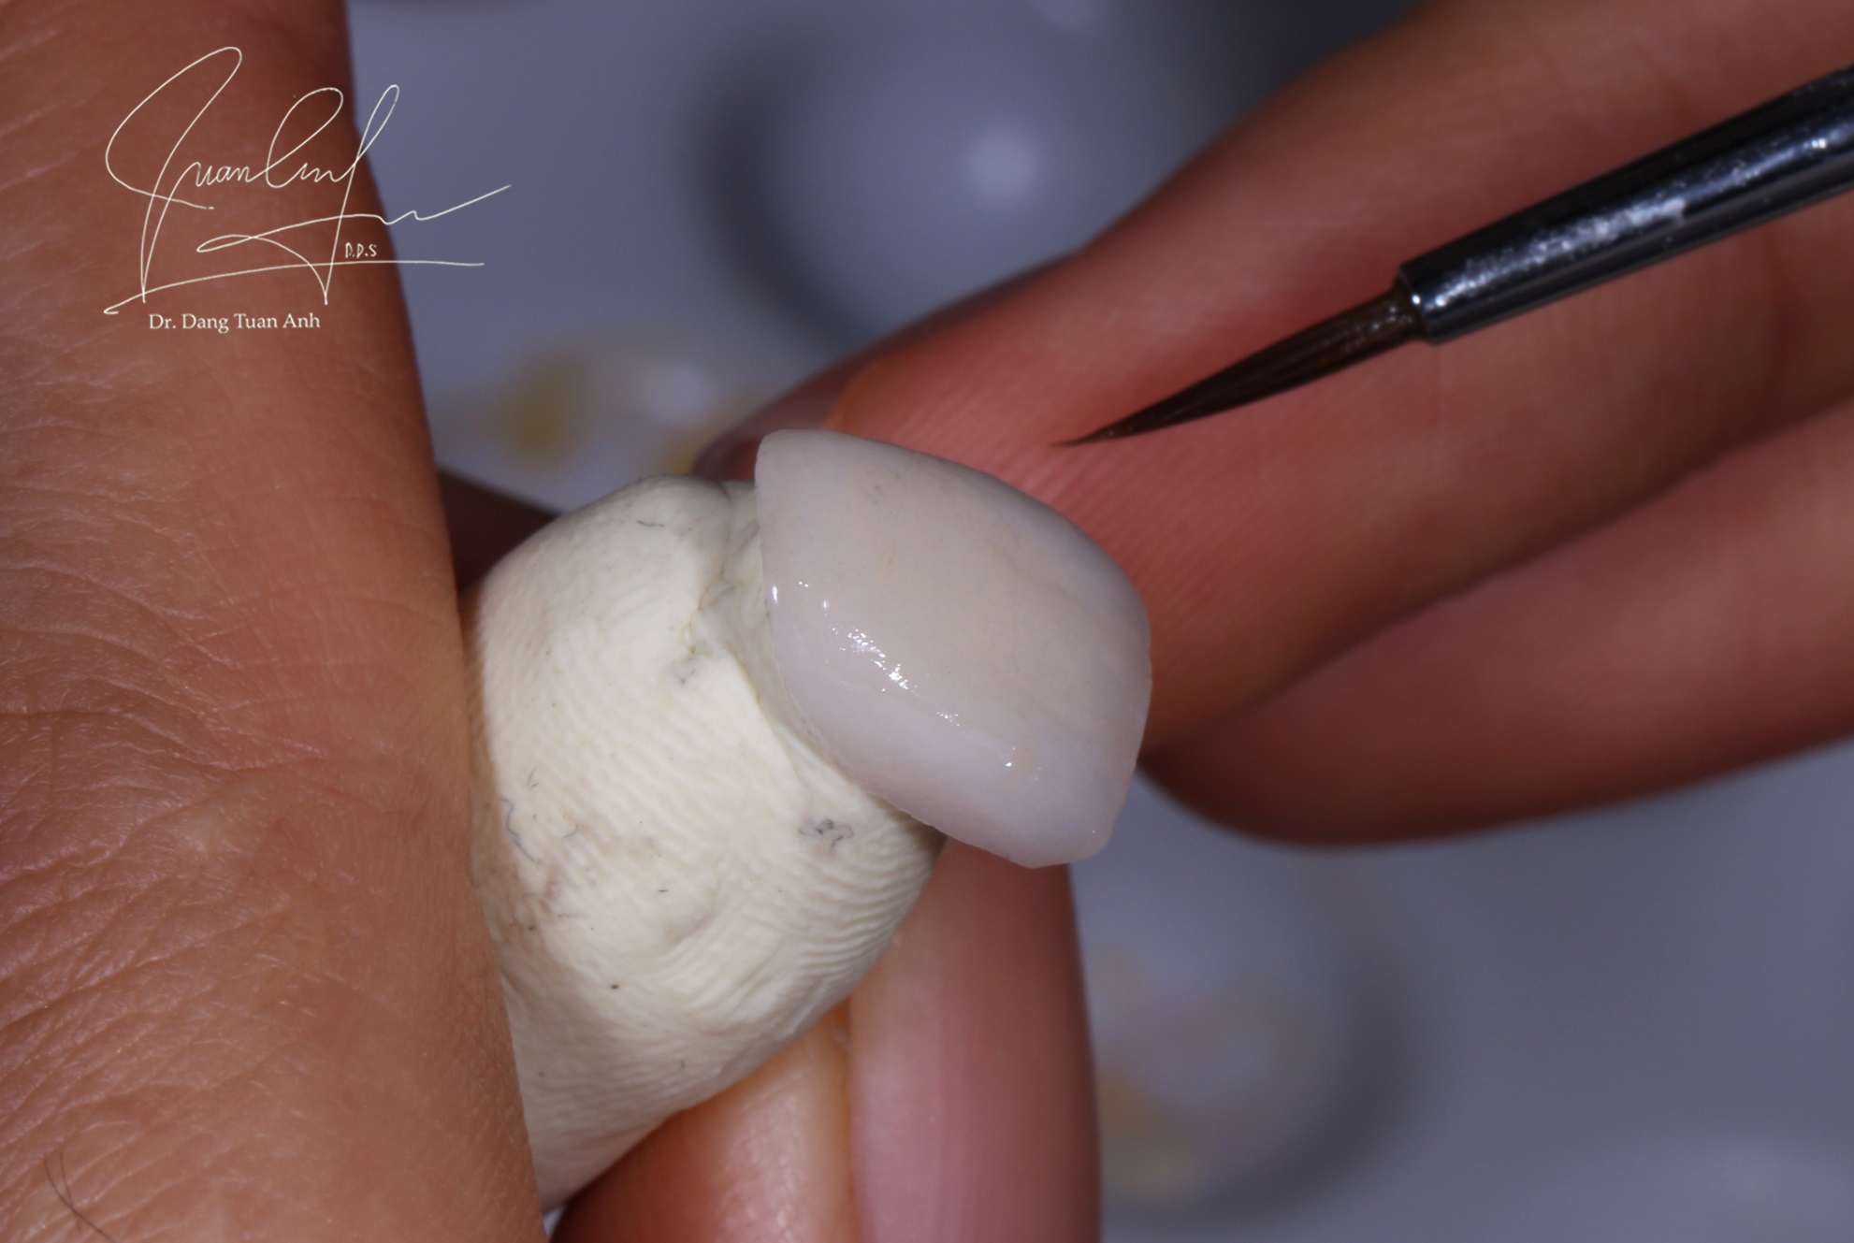
Laboratory procedure

Slide 42
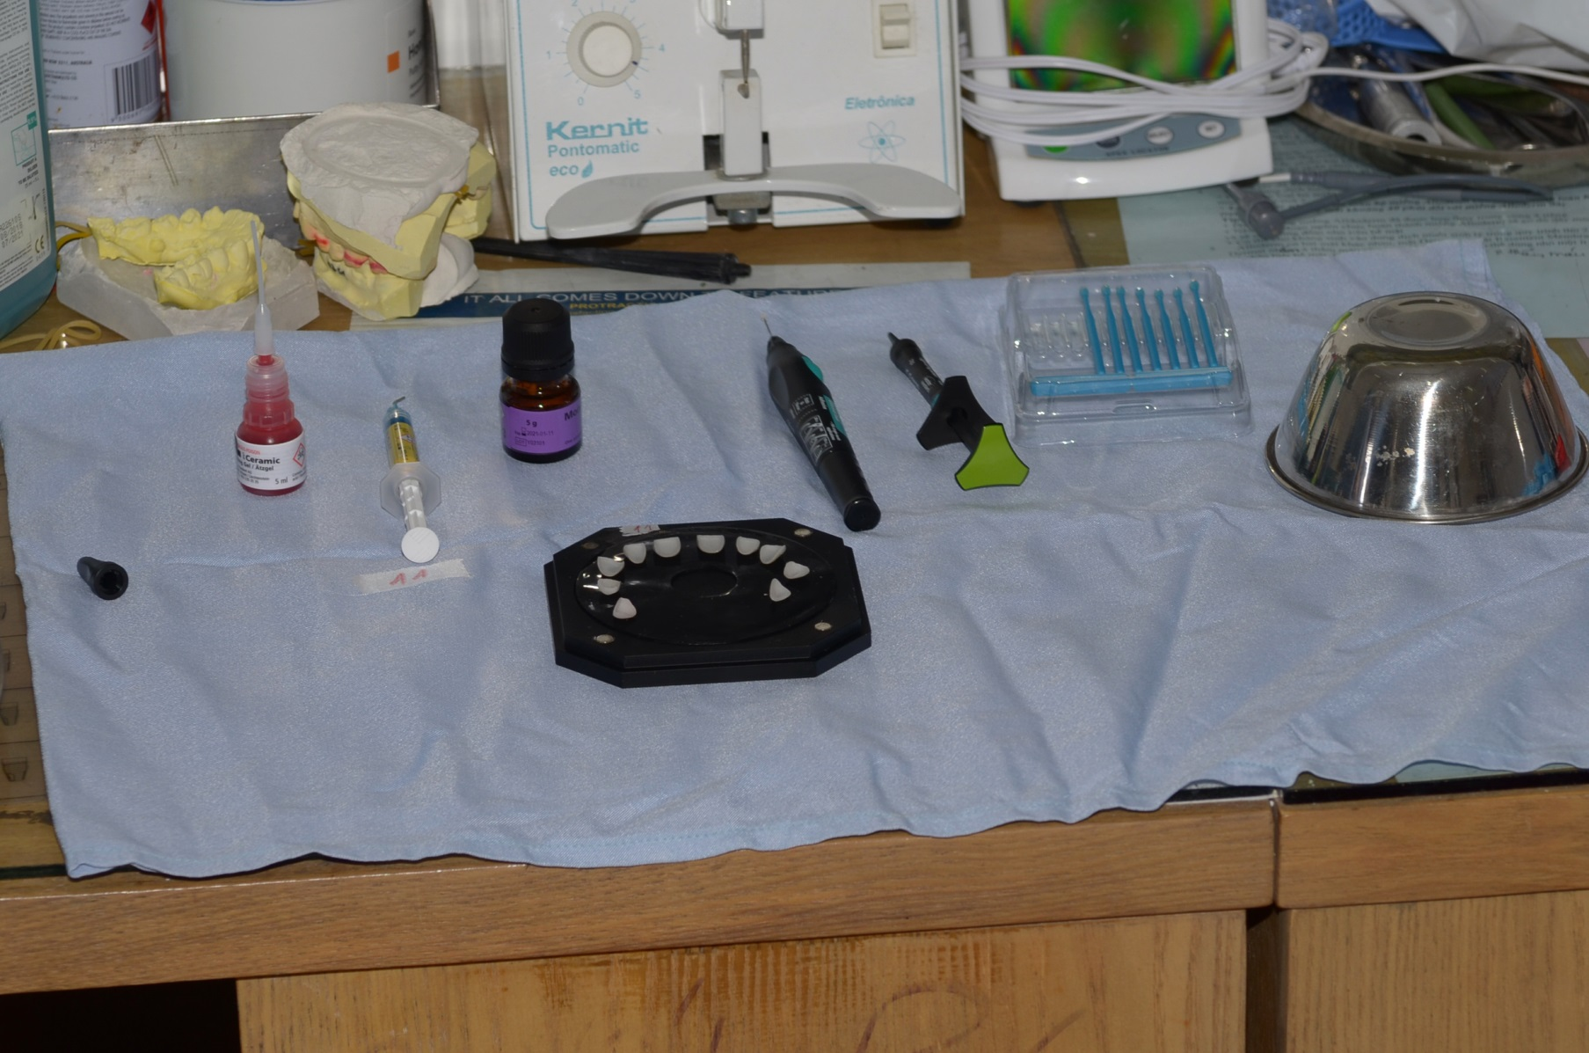
Preparing for cementation

Slide 43
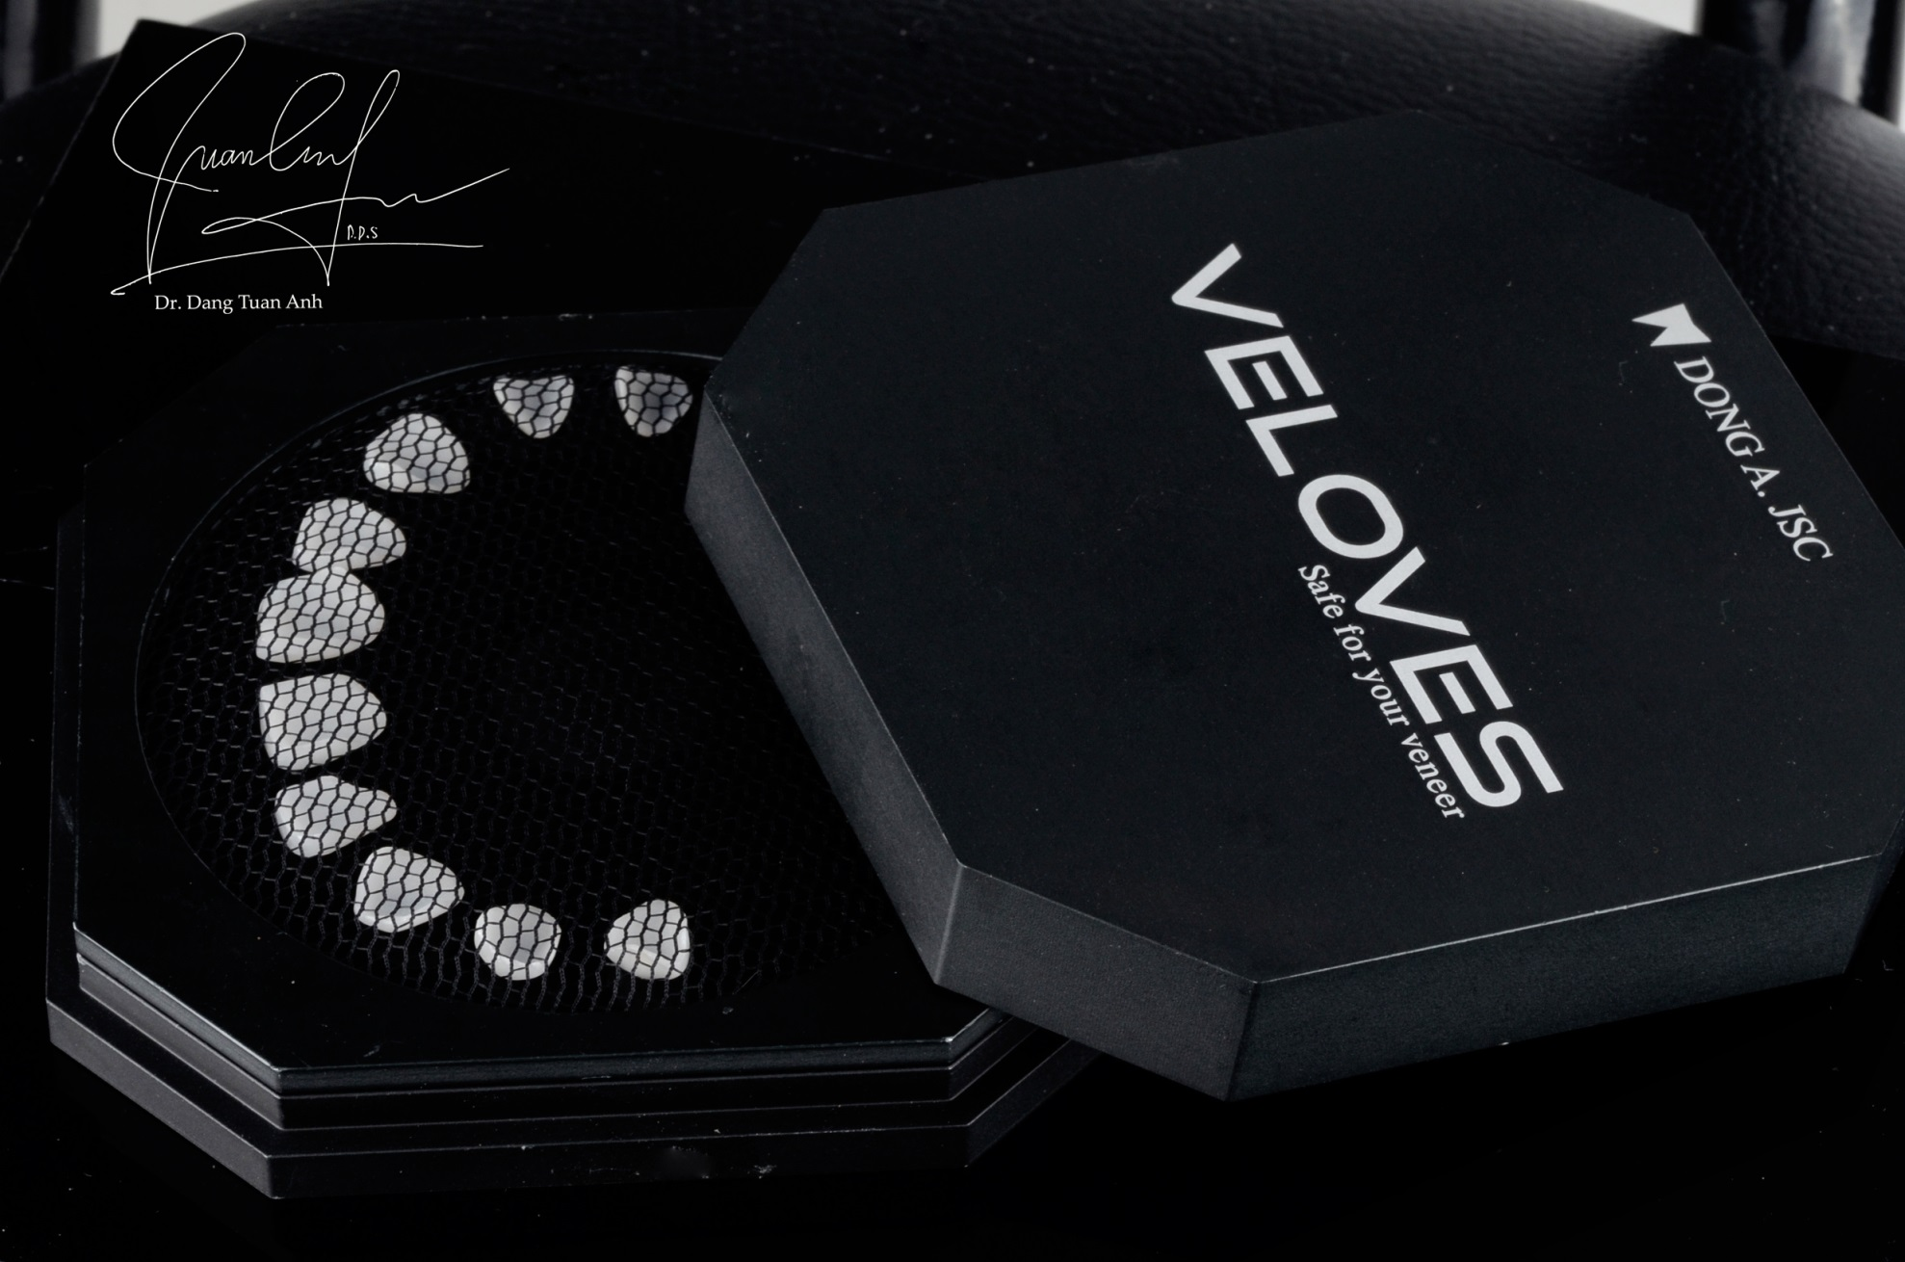
Preparing for cementation

Slide 44
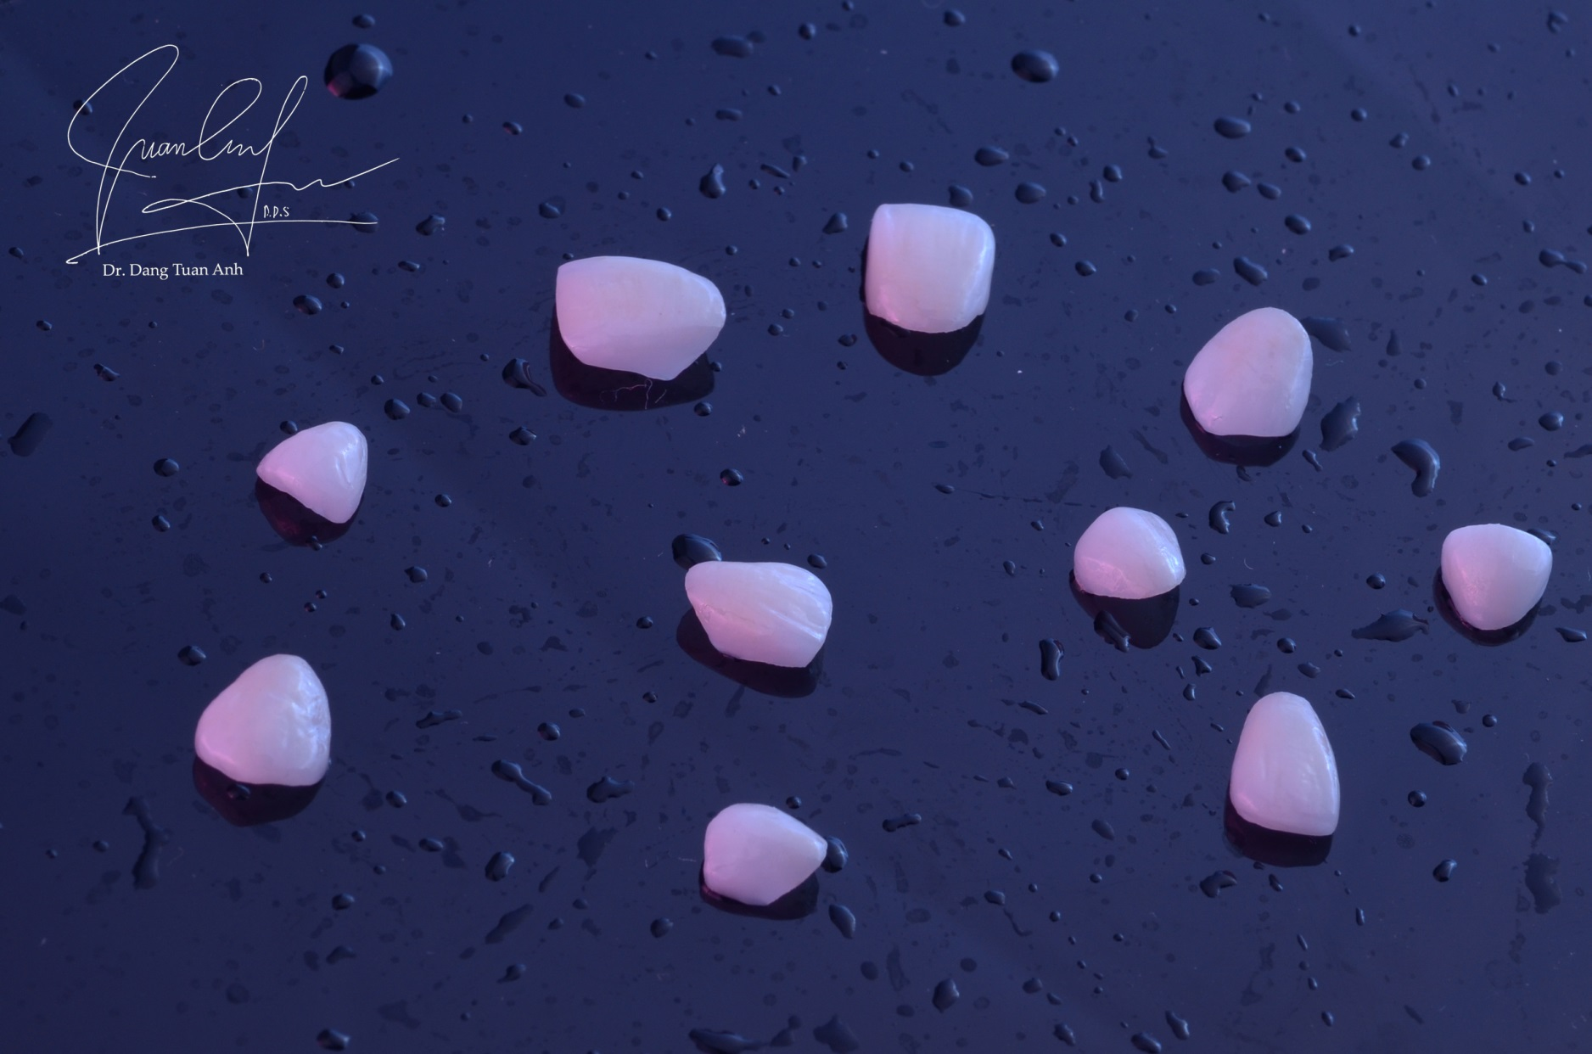
Artistic

Slide 45
Artistic

Slide 46
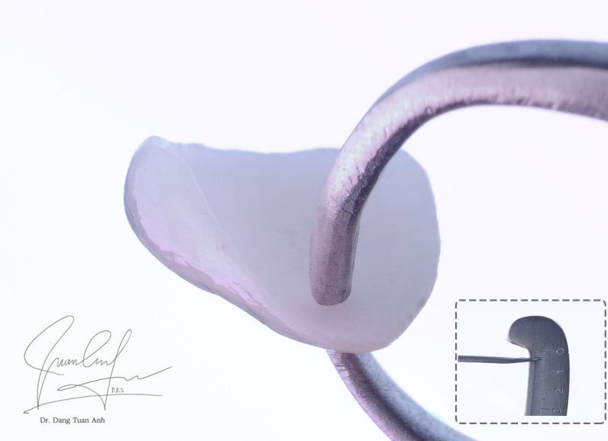
Canine veneer with the thickness of 0.4mm

Slide 47
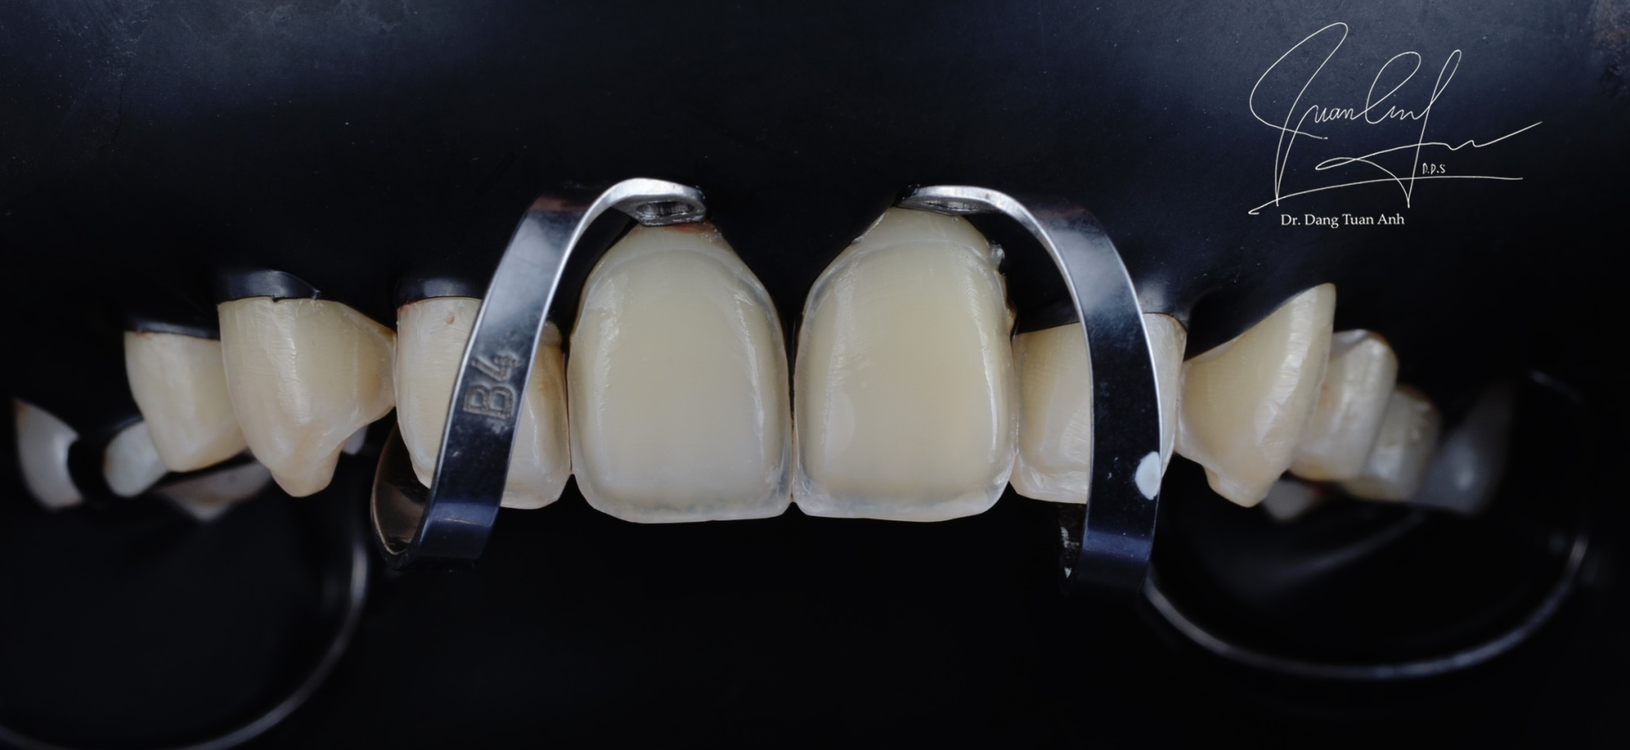
Isolation with Rubber dam kit

Slide 48
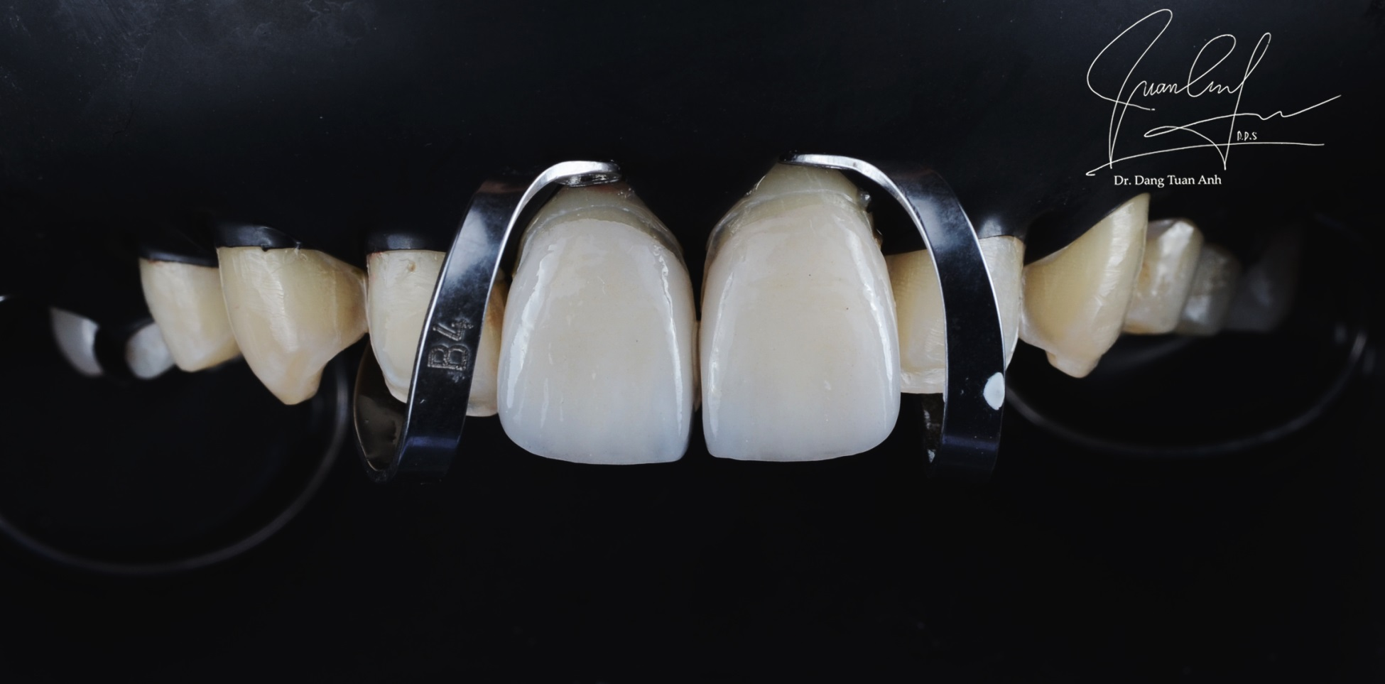
Try-in

Slide 49
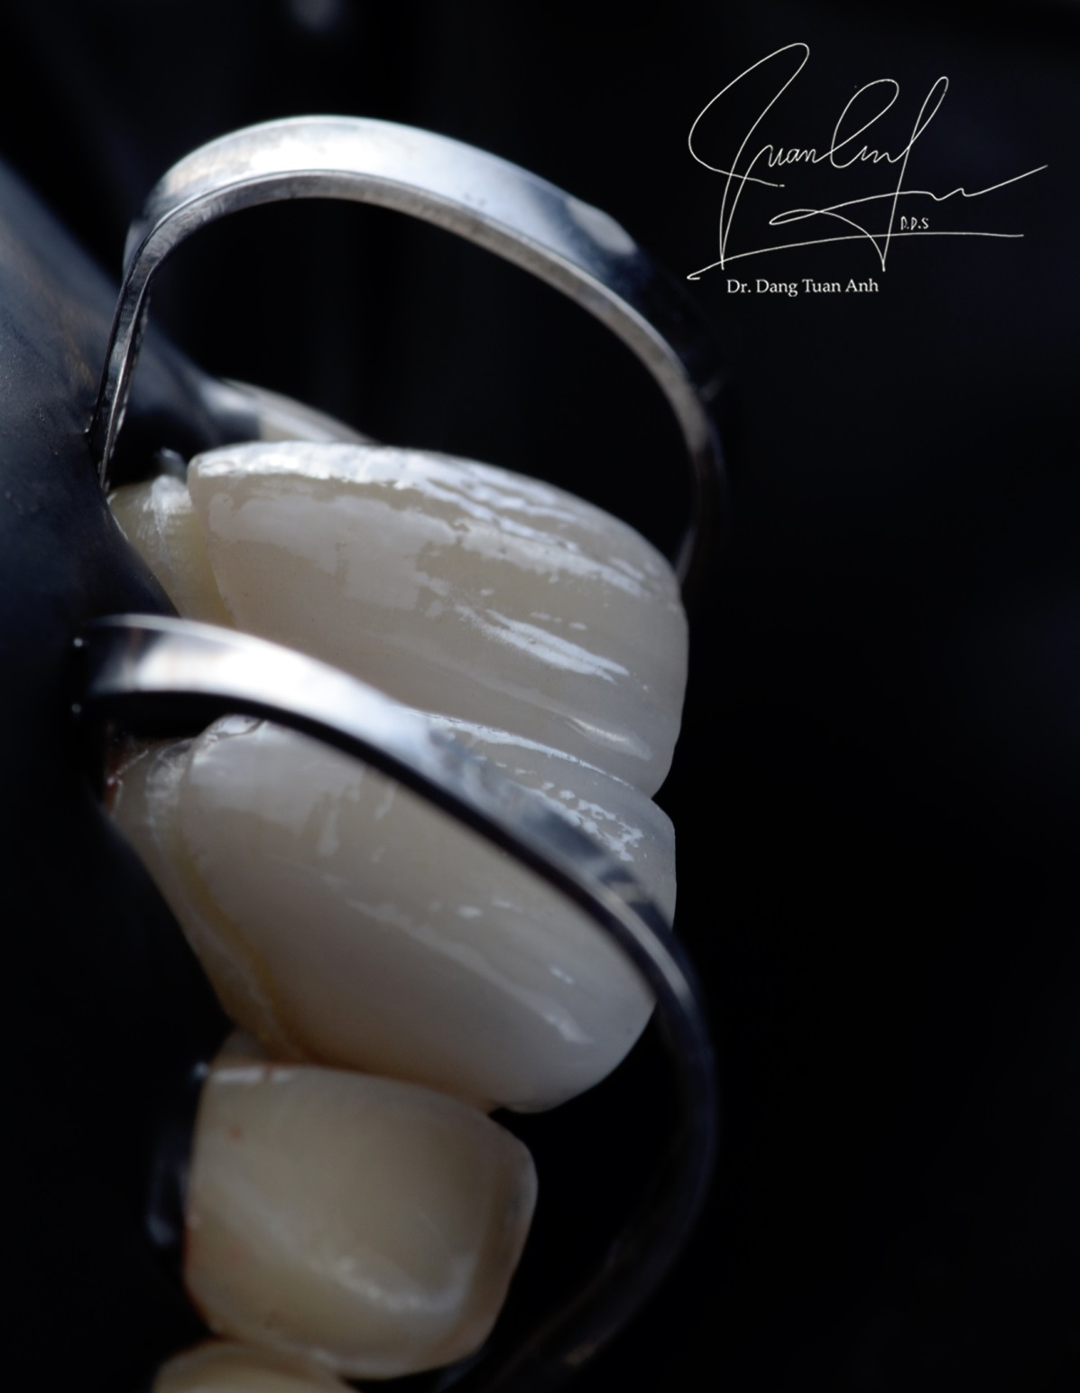
Try-in

Slide 50
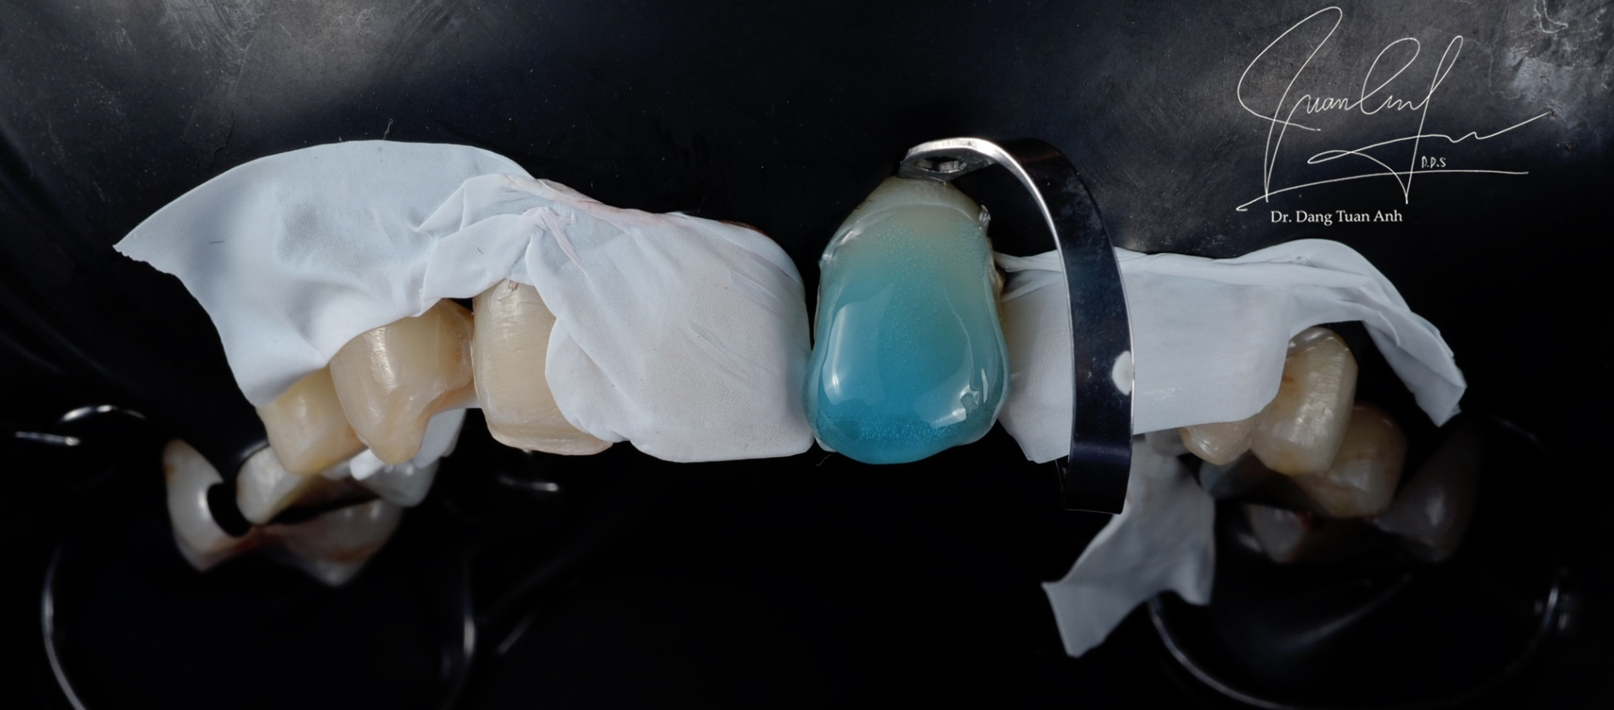
Etching with Phosphoric acid 37%

Slide 51
Etched surface

Slide 52
Bonding

Slide 53
Removing excess cement

Slide 54
Removing excess cement

Slide 55
Applying glycerin at the margin

Slide 56
Light curing

Slide 57
Intra-oral right after cementation

Slide 58
Thanks for your attention

